Slide 1
Ethical Decision-Making and Environmental Action
Dr Hugh Breakey
Research Fellow
Institute for Ethics, Governance & Law, Law Futures Centre, Griffith University

Slide 2
Overview
Everyday ethical decision-making.
Modelling more complex ethical decision-making.
Making environmentally ethical decisions: Challenges and Opportunities.

Slide 3
Ethics is easy!!
Sometimes, ethical decision-making is the easiest thing in the world.
Imagine a scenario where you have promised a beloved niece to play with her after dinner. When dinner is complete, she reminds you of your promise, and off you go.
What could be simpler?
But you actually worked your way through a number of distinct stages on your way to this successful ethical result…
Notes:
Why would anyone do a PhD on this stuff? Everything I needed to know about ethics I learned at kindergarten!

Slide 4
A Model of Ethical Decision-Making
Effective, conscientious ethical decision-making require you successfully navigate seven steps:
Awareness: You need to realize that an issue or set of choices confronting you has ethical dimensions.
‘You promised!’
Knowledge: You need to be aware of any relevant facts: Situational awareness, normative background (rules), alternatives.
It’s after dinner.
Judgment: You need to be able to reason (or intuit) your way to a defensible moral judgment about what you ought to do.
It’s morally right to live up to your promise.
Notes:
7 Steps. Though we can categorize these differently (eg 5 step, etc.)
Judgment for correct, defensible, reasonable, arguable, decent position

Slide 5
Ethical Decision-Making (cont’d)
Decision-making: You need to prioritize ethics by personally deciding to follow through on your judgment.
‘Of course I’ll do what’s right by my beloved niece!’
Taking action: You must translate your decision into action (perhaps requiring courage or perseverance).
‘Let’s do this!’
Proper Performance: Sometimes, just making an effort is enough – but other times you may be required to live up to certain standards of performance.
Reflection: Reviewing the decision and its impact – and perhaps working out how to get a better result in future.

Slide 6
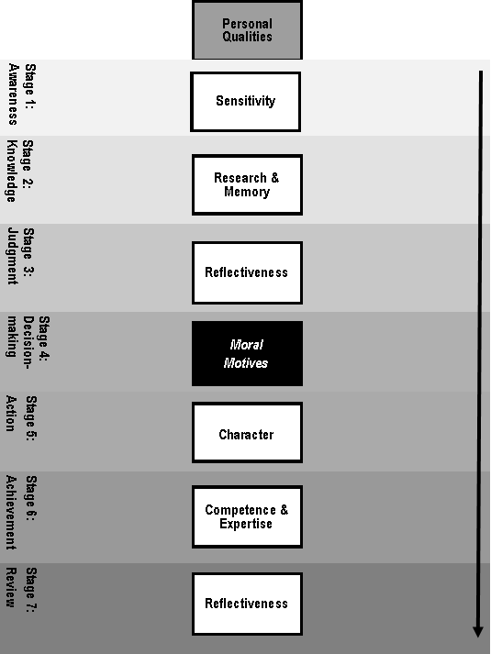

Slide 7
Problems ahoy!
Each step can be navigated in different ways – often by an array personal and interpersonal qualities, and might also be helped along by the social/institutional context.
However, breakdowns can occur at any of the stages in ethical decision-making, leading to bad outcomes – even for moral agents genuinely trying to do their best.
Breakdowns can also occur when institutions are faced with the need for ethical action, but where awareness, knowledge, authority, motive and the power to act can be disbursed across different agents.
But institutions can also offer opportunities!
Notes:
Often it is more problem-solving to focus on fixing gaps in capacities and processes, rather than assuming the problem is a moral one.

Slide 8
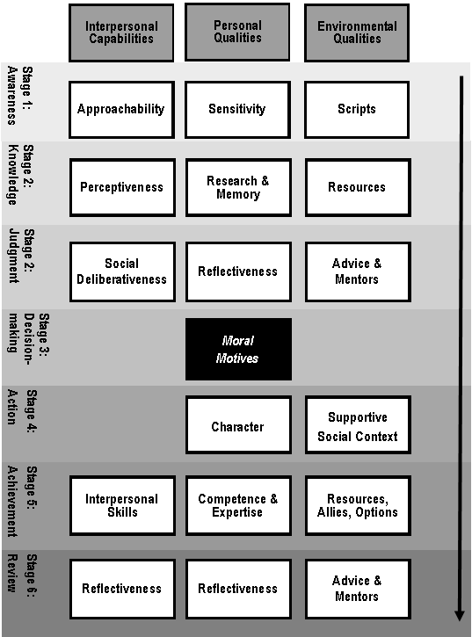

Slide 9
Ethical decision-making on environmental issues
Can you think back to decisions about environmental action that you or your organization have made (or failed to make…) where you were not satisfied with the outcome?
Environmental ethical decision-making carries many opportunities for breakdowns at each stage.
Awareness: Contribution to environmental harms can be invisible and silent.
Knowledge: While some knowledge is quite sufficient for decision-making purposes, at other times it can be a challenge to understand ecological processes and environmental impacts.

Slide 10
Environmental decision-making (cont’d)
Judgment: While some judgments are easy, other can call for difficult prioritization among incommensurate values (e.g., human life, biodiversity, animal rights, endangered species, native flora, etc.).
Motivation: The lack of social visibility and widespread peer support for environmental decision-making can make positive motivation harder to secure, and increase incentives for non-compliance.
Action: Courage, patience and perseverance can be required.
Proper performance: Difficulties here depend on the type of action – e.g., saving wildlife, raising awareness, generating problem-solving policies.
Reflection: Getting feedback on results can be hard.

Slide 11
Conclusion
When thinking about how people and organizations can make better environmental decisions, it is important to focus not only on questions of motive and judgment, but on all the social, personal and interpersonal capabilities that are required for successful action.

Slide 12
References
The seminal work on models of ethical decision-making is:
Rest, James. ‘Morality’ in Handbook of Child Psychology, edited by Paul Mussen, 556-629. New York: John Wiley & Sons, 1992.
For an overview of the presented model of ethical decision-making, and further references, see:
Breakey, Hugh. ‘Building Ethics Regimes: Capabilities, Obstacles and Supports for Professional Ethical Decision-Making.’ University of New South Wales Law Journal 40, no. 1 (2017): 322-52. http://www.unswlawjournal.unsw.edu.au/sites/default/files/401-13.pdf (Open Access)

