Slide 1
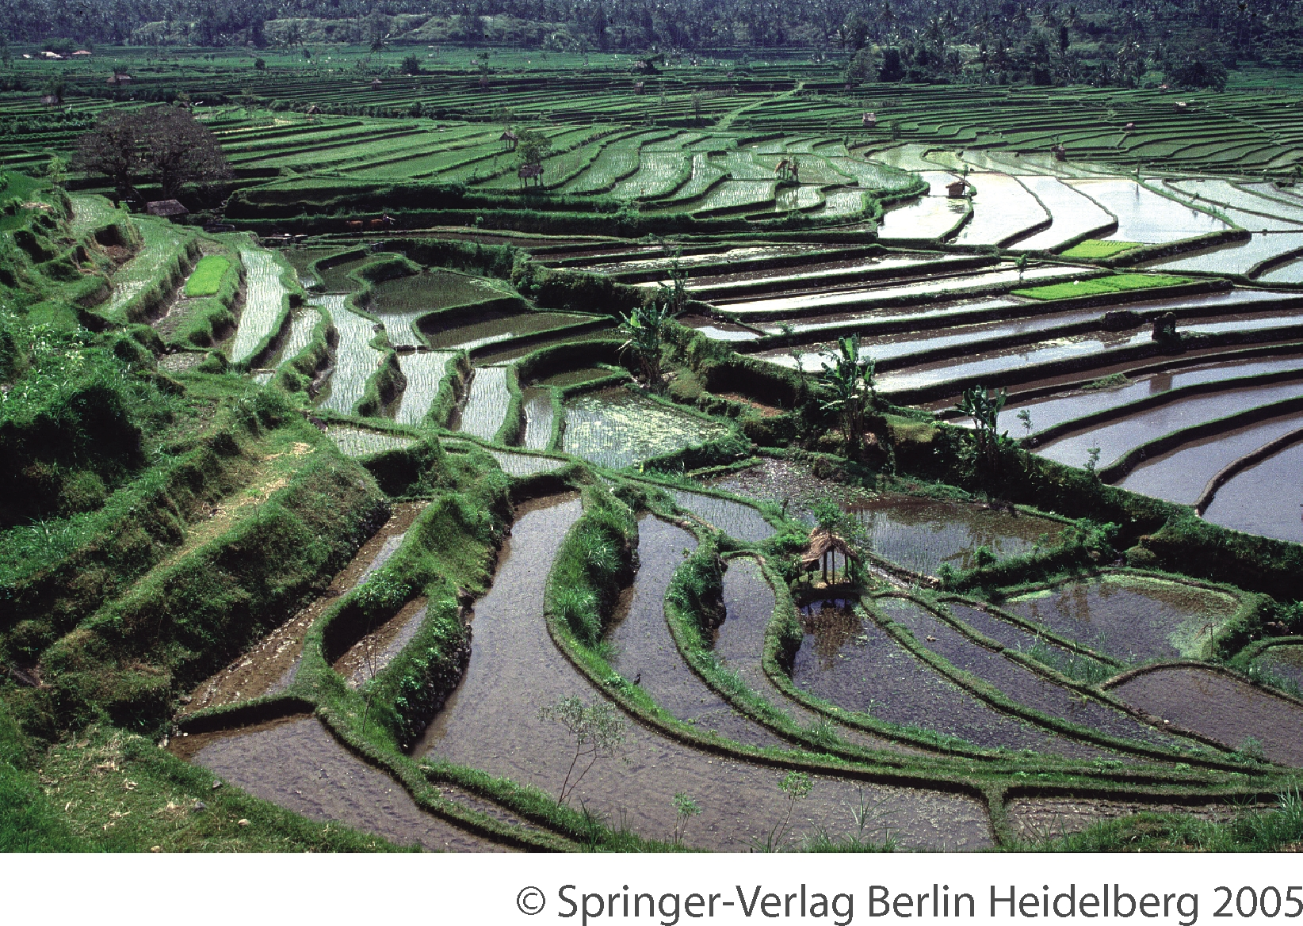
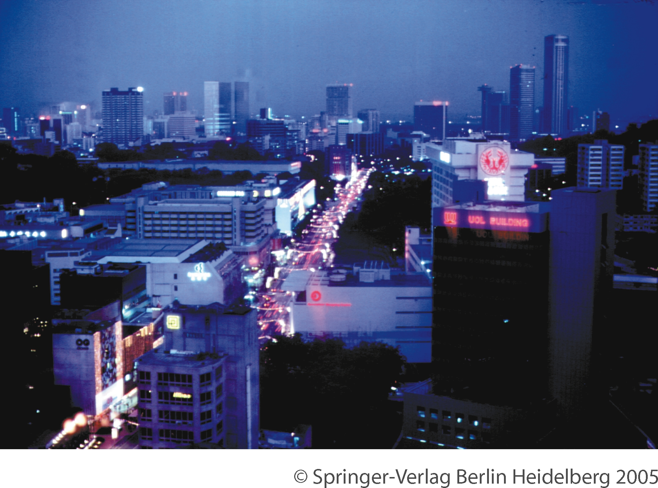
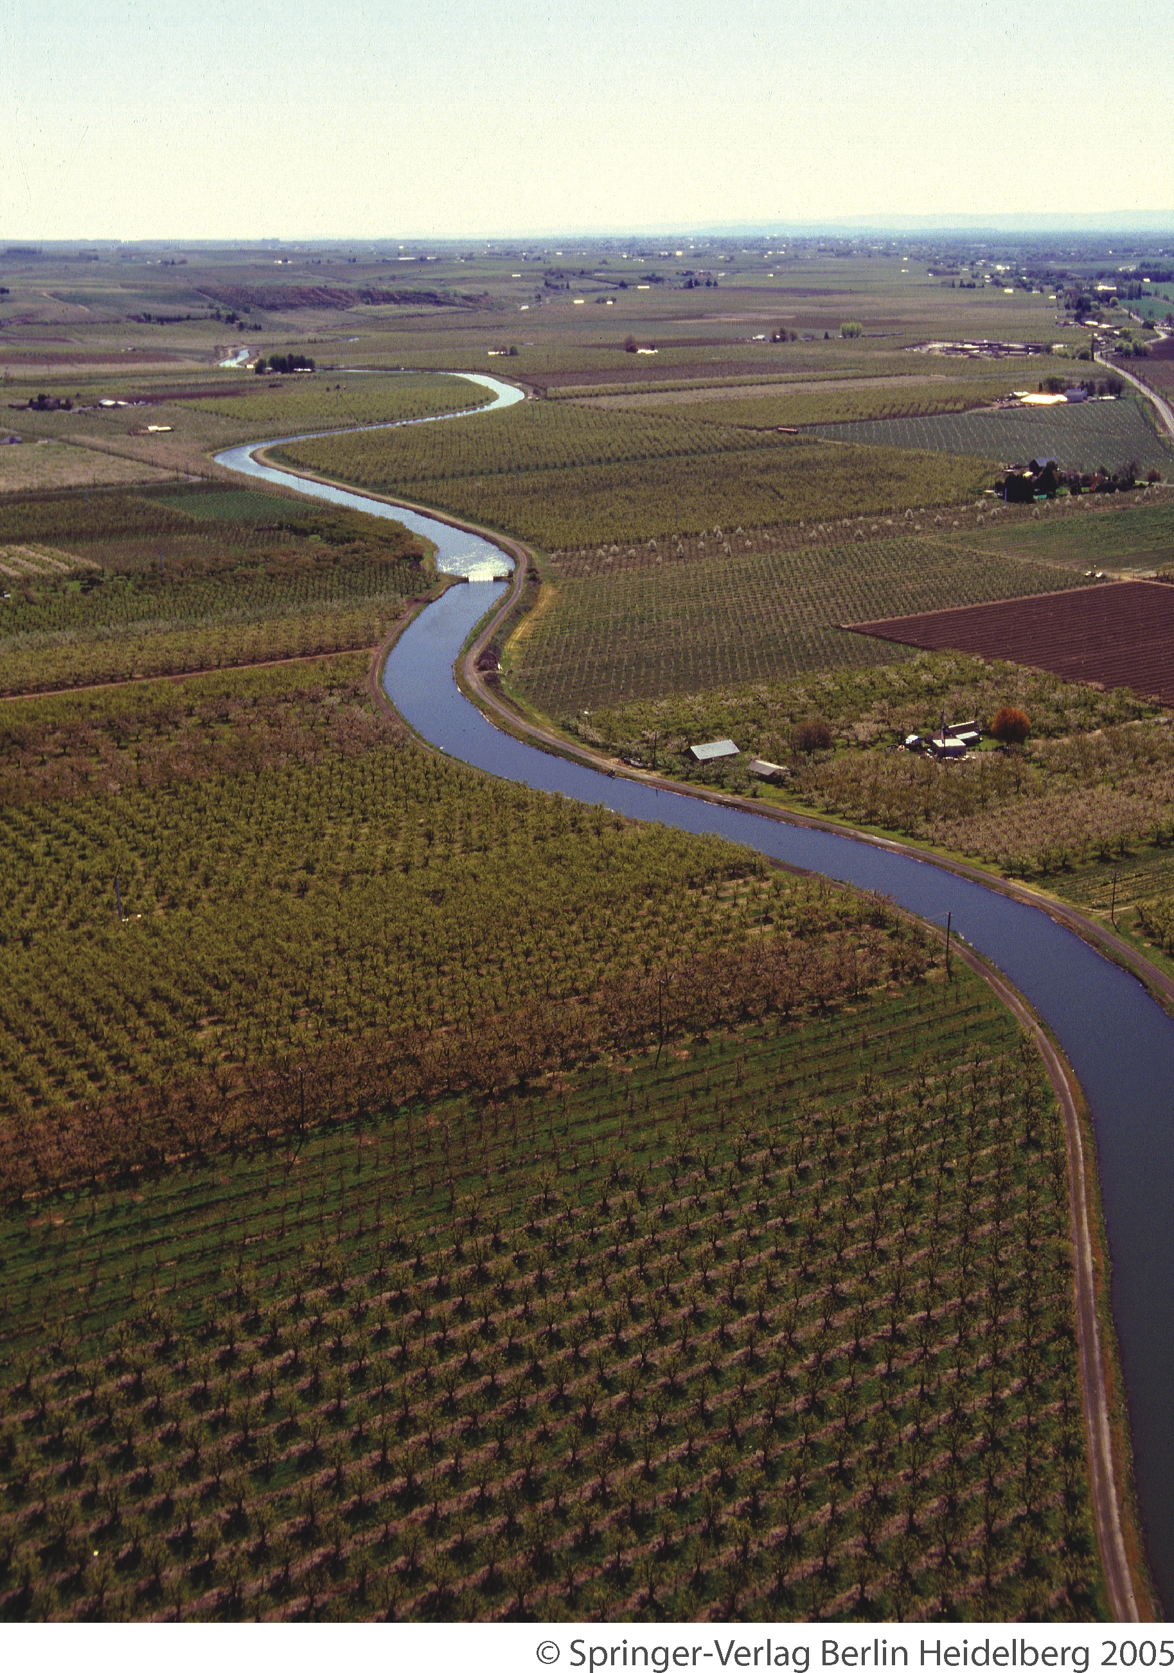
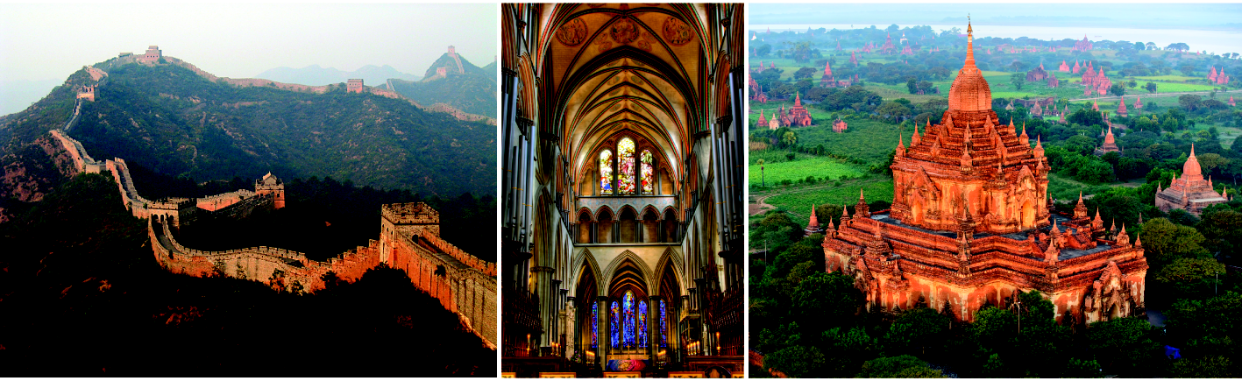
The Anthropocene:
The scientific base for planetary boundaries
Will Steffen

Slide 2
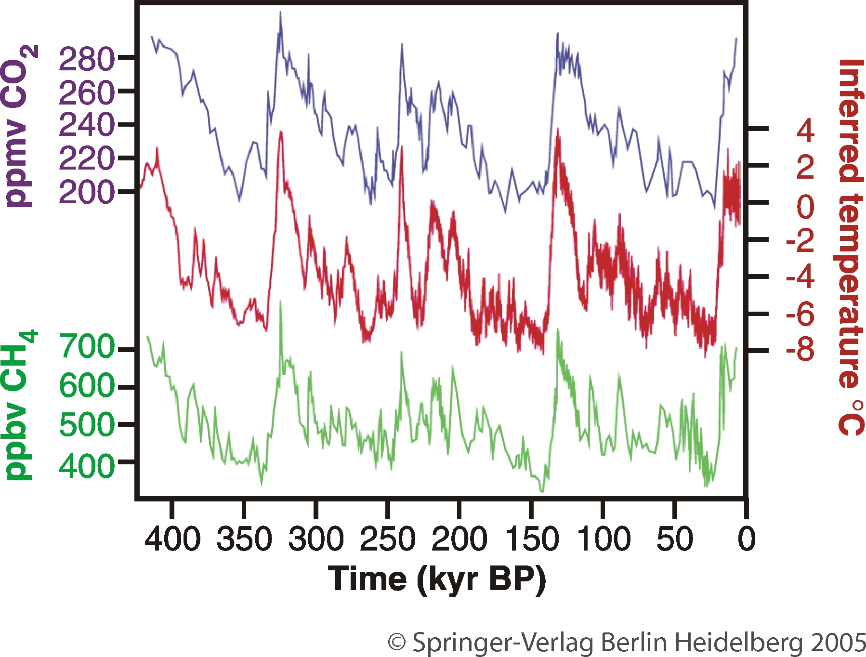
Human Development and
Earth System Dynamics
Beginning of agriculture
Evolution of fully modern
humans in Africa
Hunter-gatherer societies only
Adapted from Steffen et al. 2004; ice core data from Petit et al. 1999

Slide 3
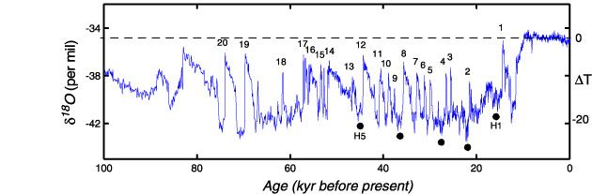
Human Development and
Earth System Dynamics
Holocene
First migration of
fully modern humans
out of Africa
Aborigines
arrive in
Australia
Migrations from South Asia
to Europe
Beginning
of
agriculture
Great Asian,
European, African,
American
civilisations
Source: GRIP ice core data (Greenland)
and S. Oppenheimer, ”Out of Eden”, 2004

Slide 4
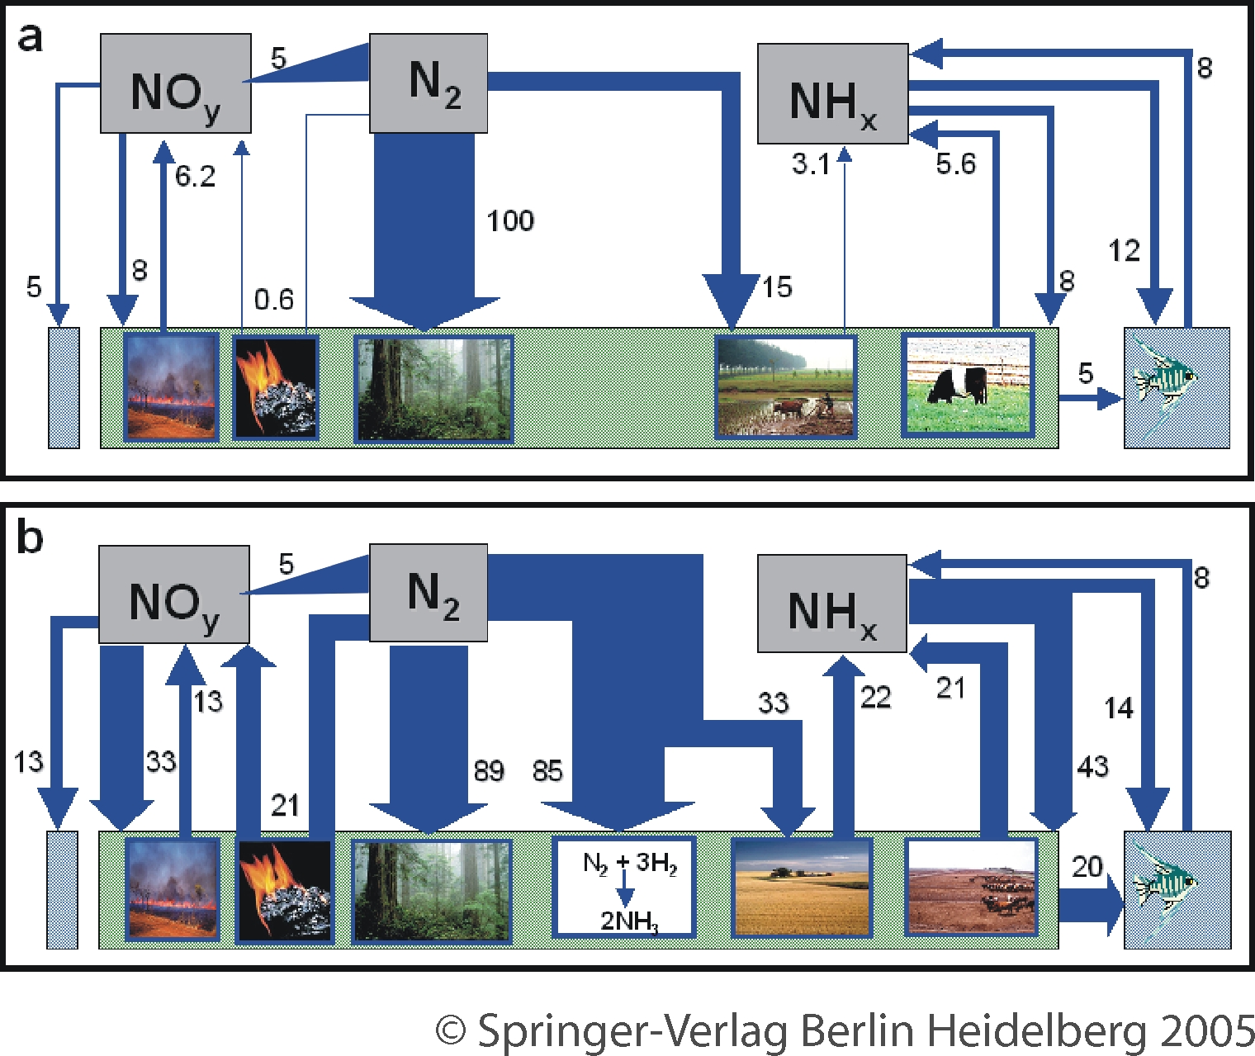
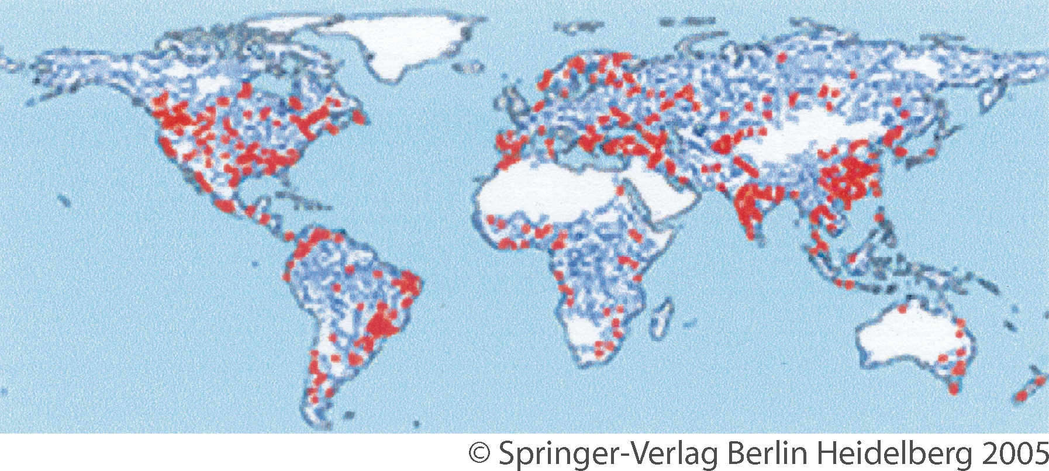
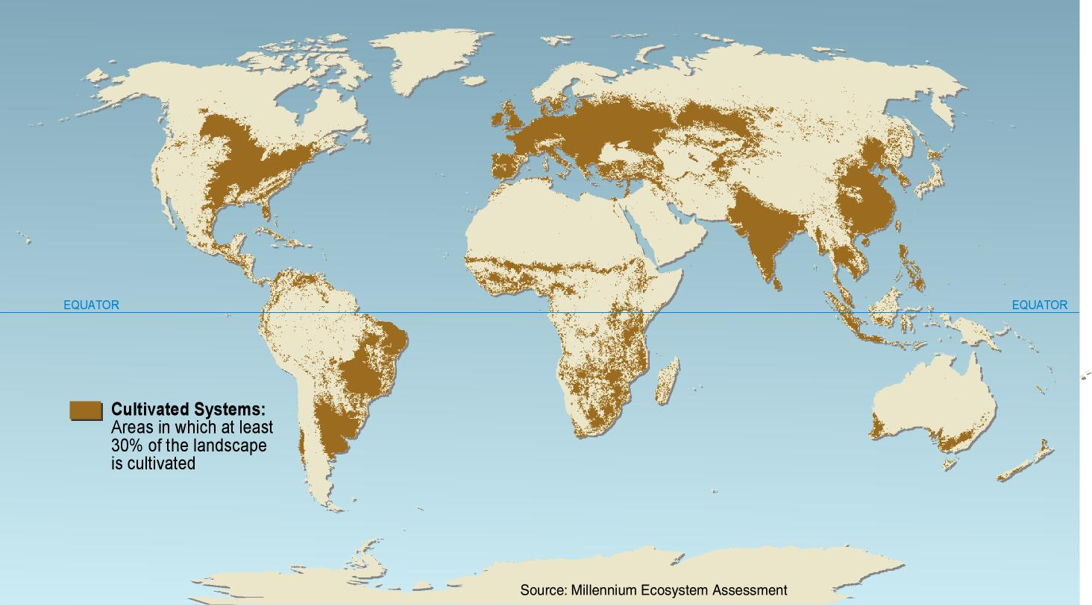
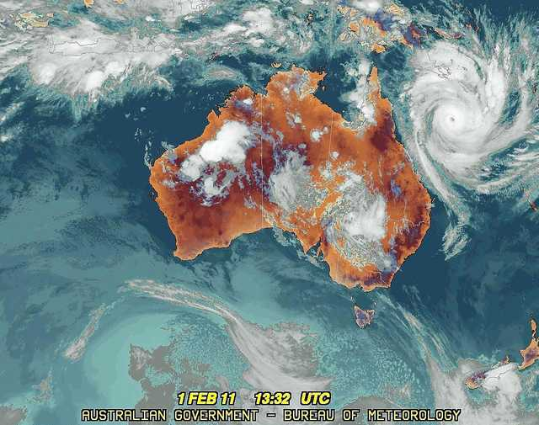
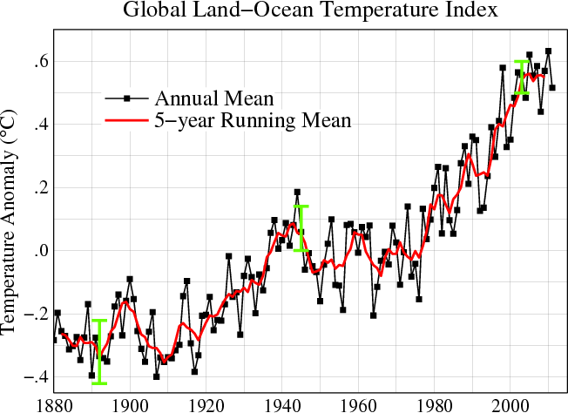
Global Change and the Anthropocene

Slide 5
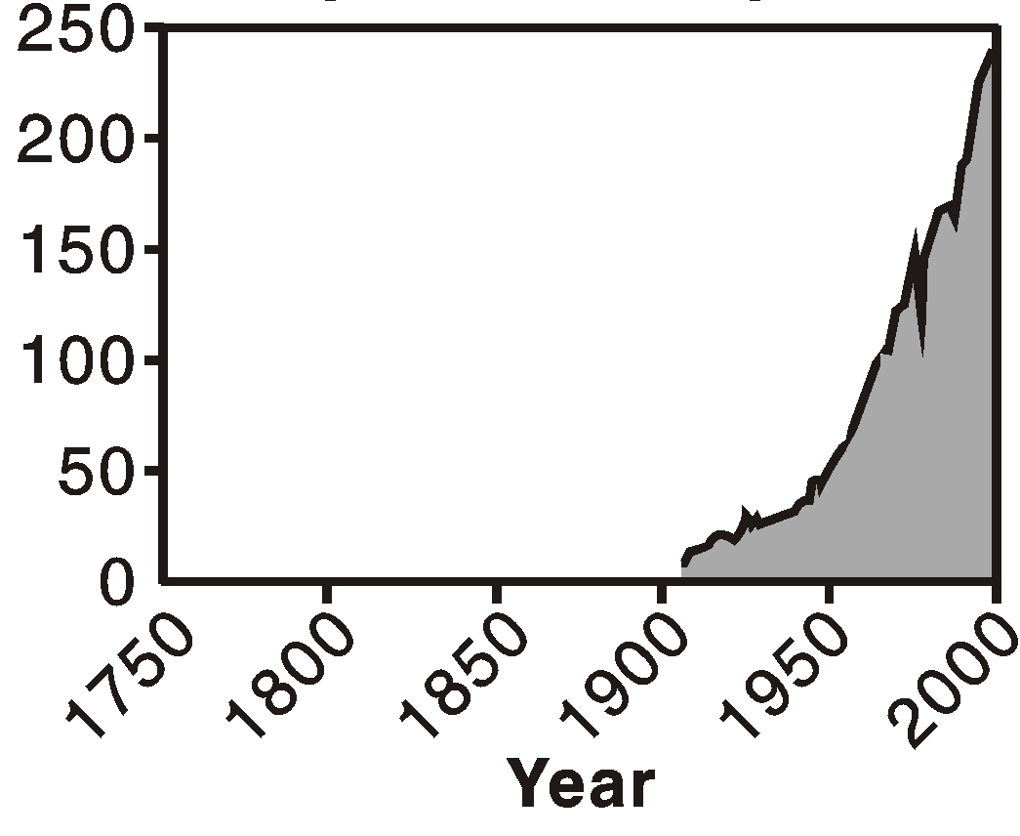
Anthropocene graphs
Vertical axis is a
human activity or an
impact on the Earth
System. All variables
shown in a linear
scale.
!!!!
Steffen et al. 2004

Slide 6
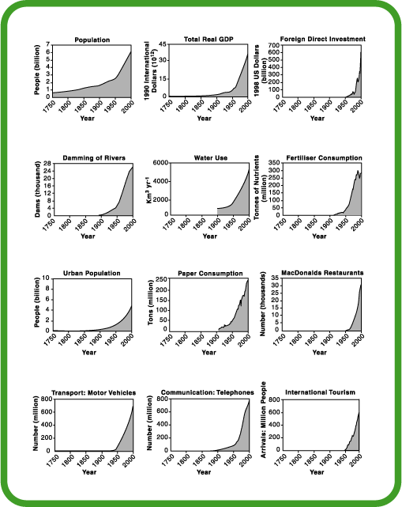
The Human Enterprise
Population
Economic Growth
Freshwater use
Resource consumption-fertilizer, paper
Urbanization
Globalization
Transport
Communication
Note ”The Great Acceleration” from 1950 to 2000
From Steffen et al. 2004

Slide 7
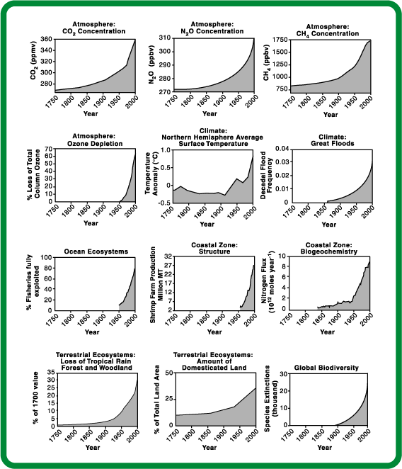
The Global Impact
Greenhouse gases
Ozone depletion
Climate
Marine ecosystems
Coastal zone
Nitrogen cycle
Tropical forests
Land systems
Biodiversity
From: Steffen et al. 2004

Slide 8
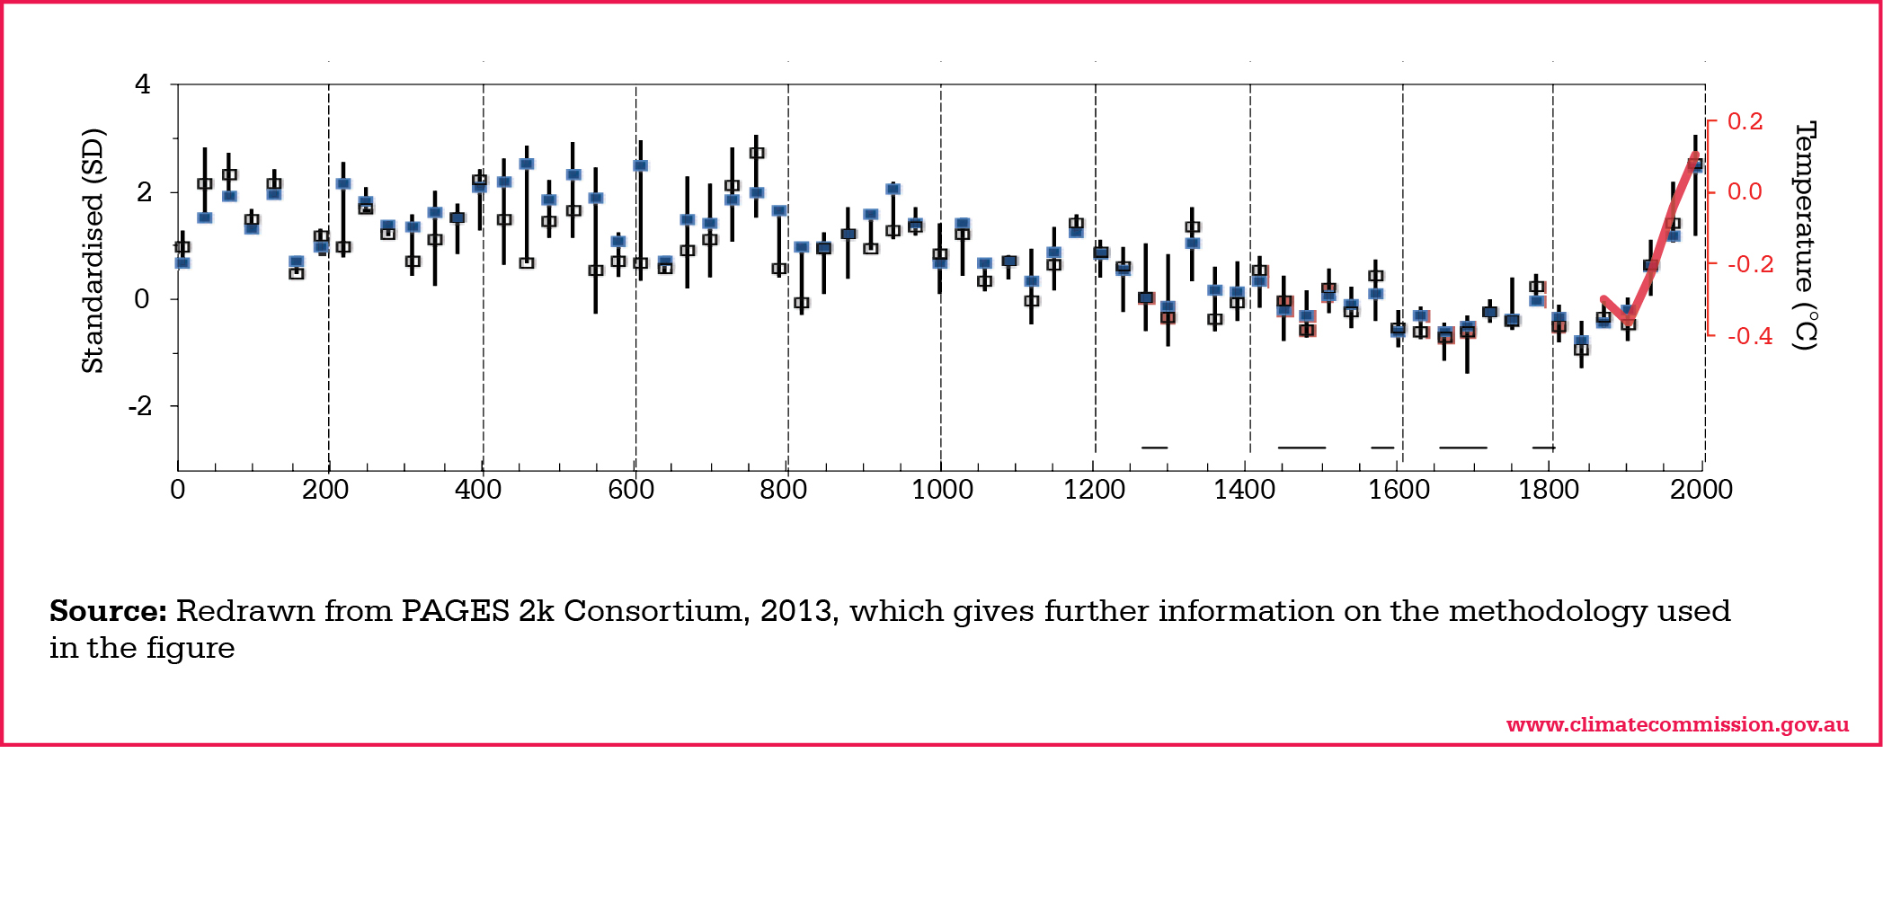
Temperature rise:
Beyond the envelope of natural variability?

Slide 9
Implications of accelerating climate change
IPCC temperature projections
IPCC 2007

Slide 10
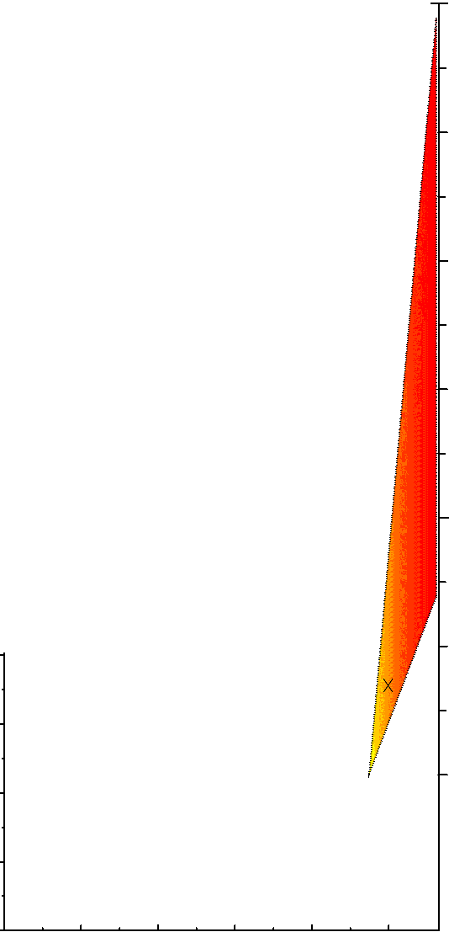
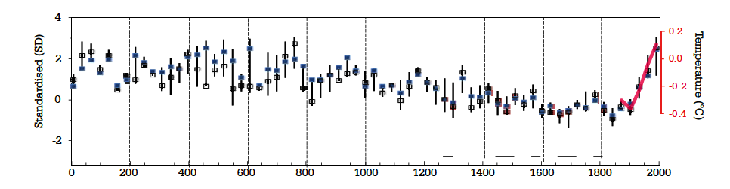
6
Earth System moves to a new
state? Severe challenge to
contemporary civilisation.
Possible collapse?
IPCC Projections
2100 AD
5
4
Global Temperature (°C)
3
Committed
2
1
Now
0
IGBP PAGES

Slide 11
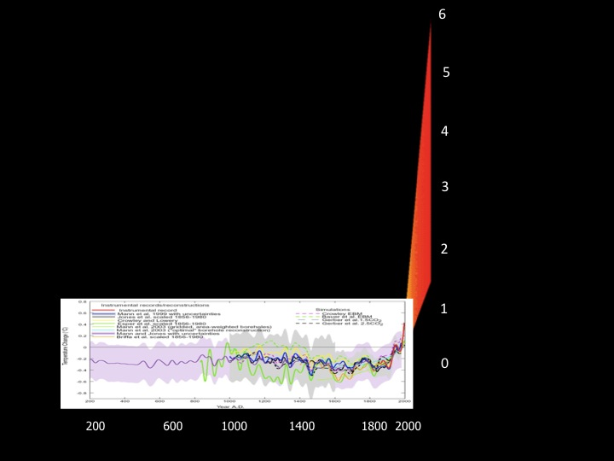
Implications of the Anthropocene
Transition to a new, much
hotter state of the
Earth System?
Tipping Point?
Return towards a
Holocene-like state?

Slide 12
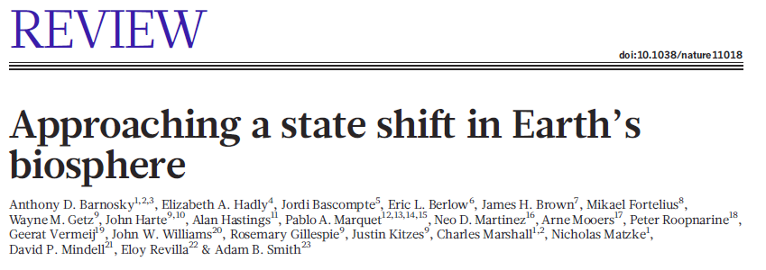
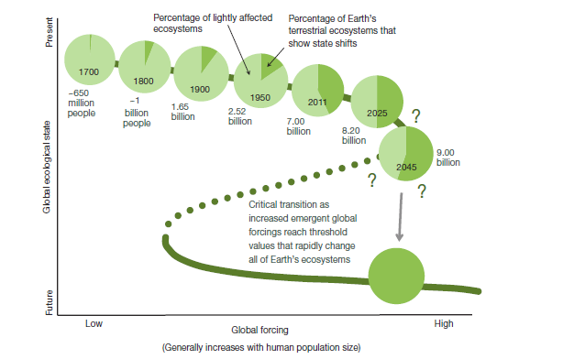

Slide 13
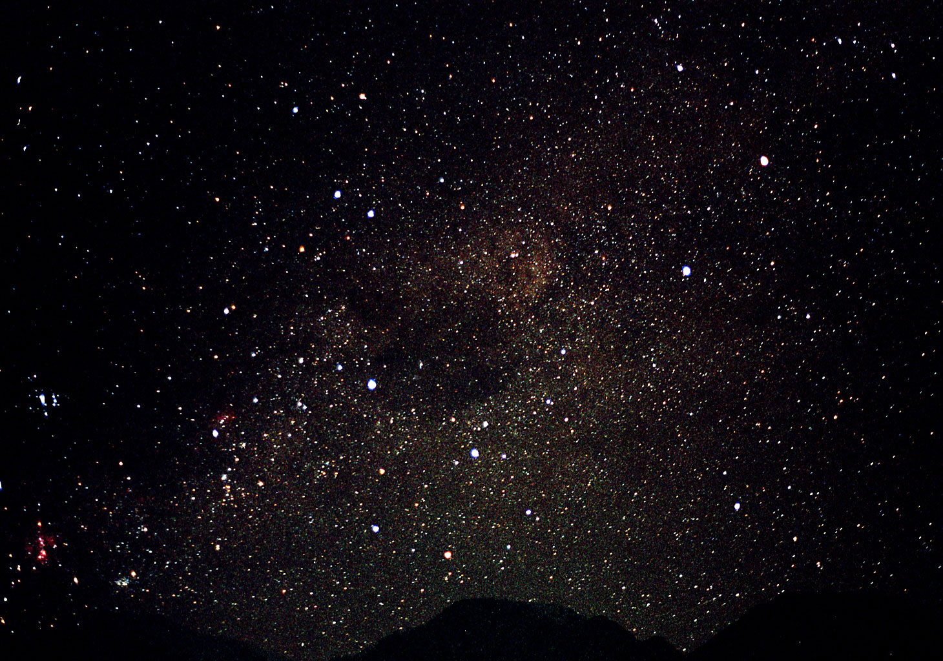

States of the Earth System
Holocene
Ice Age

Slide 14
States of the Earth System
Hot, Ice-free
State
Holocene
Ice Age

Slide 15
States of the Earth System
Hot, Ice-free
State
Holocene
Ice Age

Slide 16

Biogeochemistry: Global N & P Cycles
Ozone
depletion
Atmospheric Aerosol
Loading
Climate
Change
Planetary
Boundaries
Chemical
Pollution
Rate of Biodiversity
Loss
Global
Freshwater
Use
Land System Change
Ocean
acidification
Rockström et al. 2009

Slide 17
Climate Change
< 350 ppm CO₂ < 1W m²
(350 – 500 ppm CO₂ ;
1-1.5 W m²)
Ozone depletion
< 5 % of Pre-Industrial 290 DU
(5 - 10%)
Biogeochemical loading: Global N & P Cycles
Limit industrial fixation of N₂ to 35 Tg N yr⁻¹(25 % of natural fixation)
(25%-35%)
P < 10× natural weathering inflow to Oceans
(10× – 100×)
Atmospheric Aerosol Loading
To be determined
Planetary
Boundaries
Ocean acidification
Aragonite saturation ratio > 80 % above pre-industrial levels
(> 80% - > 70 %)
Rate of Biodiversity Loss
< 10 E/MSY
(< 10 - < 1000 E/MSY)
Global Freshwater Use
<4000 km³/yr
(4000 – 6000 km³/yr)
Land System Change
≤15 % of land under crops
(15-20%)
Chemical Pollution
Plastics, Endocrine Desruptors, Nuclear Waste Emitted globally
To be determined

Slide 18
PBs: further research…
Core (Foundational) Boundaries
Climate – reflects the energy balance at the Earth’s
surface; provides the fundamental geophysical
environment for the maintenance and evolution of life
Biodiversity – represents the “control panel of life”
that shapes and modulates many of the processes in the
Earth System (e.g., biogeochemical cycles)
Novel entities (new chemicals, radionuclides,
genetically modified organisms, electromagnetic radiation) –
entirely new entities created by humans and released into
the Earth System; can have unpredicted, abrupt, serious
consequences for Earth System functioning (e.g., CFCs)

Slide 19
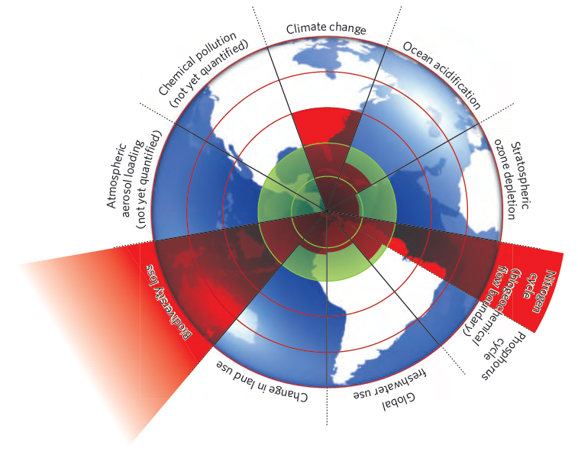
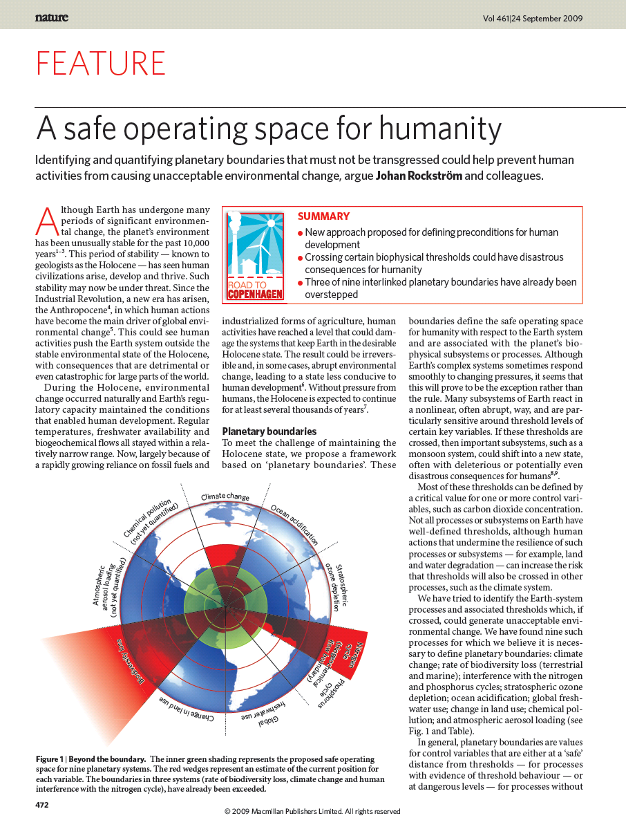
Transgressing safe boundaries
Global fresh-
water use
…
Rockström et al. 2009 Nature, 461 (24): 472-475
Notes:
19

Slide 20
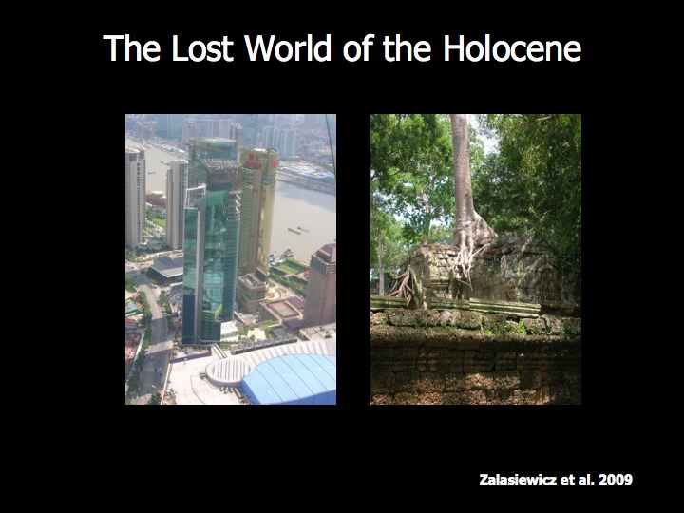
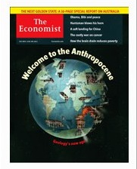
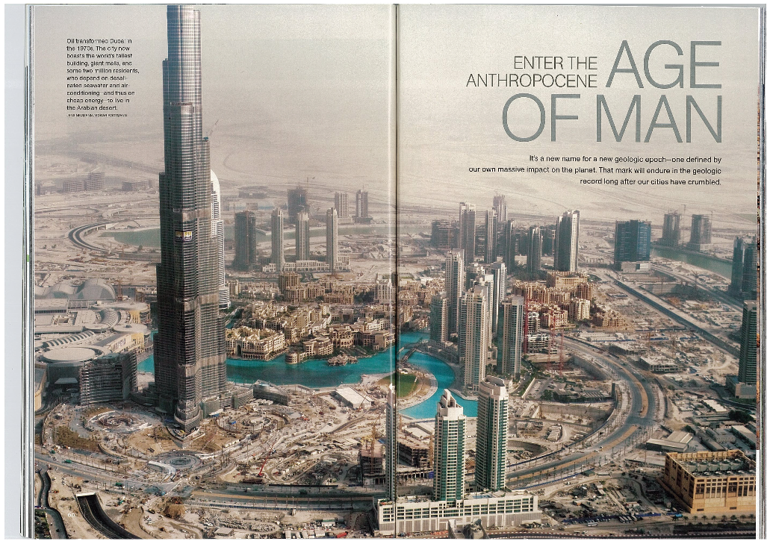

Slide 21
Evolution and the Anthropocene
Darwin’s insights about the origin of
humans - that we are apes, a part
of nature (not above it) - challenged
deeply held beliefs about the human-
environment relationship.
Will the Anthropocene evoke a similar level of deep emotion
in the public? Can humanity really affect the functioning of its own
life support system at the planetary scale? What are the
implications of this for our definition of “progress”, our way of life
and our future?
constant rate 3.2 mm/year
Source: Katherine Richardson, Copenhagen University

