Slide 1
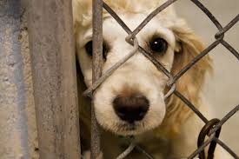
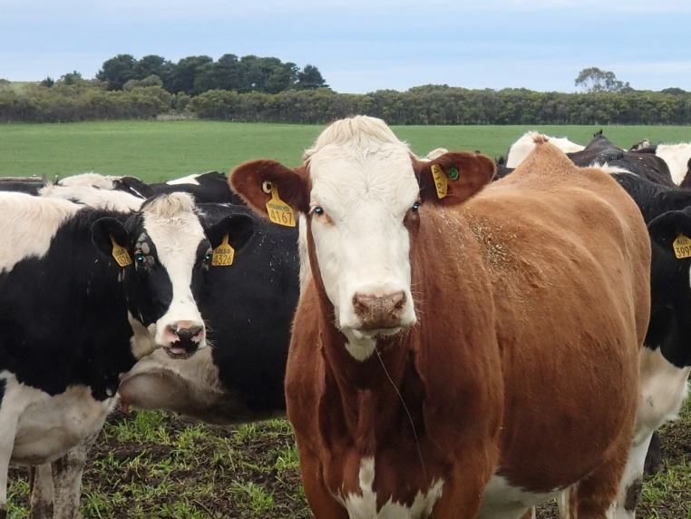
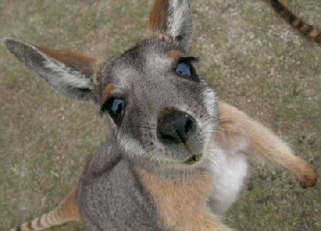
Animal law, cruelty and rights: A challenge to meaningful research in green criminology
Brodie Evans
School of Justice, QUT
B10.evans@qut.edu.au

Slide 2
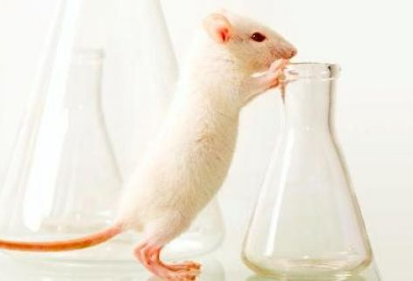
Today’s Focus
How is Green Criminology approaching animal cruelty?
‘Animal Rights’ as a research agenda – what does this mean? What are the challenges?
What/who is contributing to this discussion?
Law & Justice
Ethics & Philosophy
‘Animal rights activists’

Slide 3
Animal Cruelty in Criminology
Neglected or often approached in a human-centric way
Limiting scope of ‘cruelty’, contributing to our understanding of this concept
Examples:
Ascione (1993, 228): “socially unacceptable behaviour that intentionally causes unnecessary pain, suffering, or distress to and/or the death of an animal”.
Gullone (2012, 2): “individuals who act with the deliberate intention to cause harm to non-human sentient beings” (their emphasis).

Slide 4
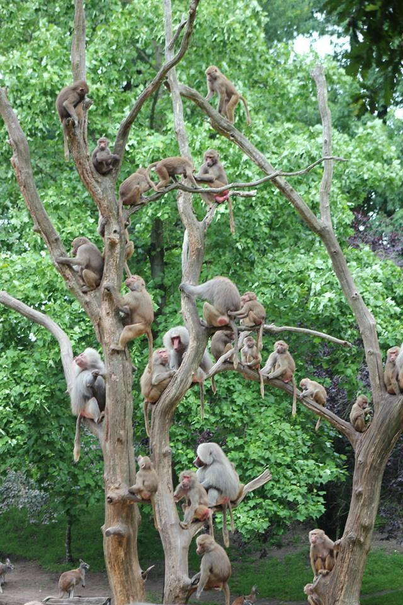
Green Criminology’s approach
Has emerged as a discipline, promoting researchers to “construct its agenda on the platform of rights for animals” (South, Brisman and Beirne 2013, 33).
Calls for a “nonspeciesist criminology” (Beirne 2006).

Slide 5
What is the challenge?
How should we define our variables:
What is cruelty?
Who are the victims and offenders?
Morally and/or legally?
Creates confusion as to how green criminologists should employ animal rights theory as a platform or be framed by the animal rights agenda, if it differs within the literature (which is multi-disciplinary) and in public and activist discourses.
Not all animal rights activists agree to the same push for legal change – disagreeing with what changes should be made. They do not present as a united front (Bourke 2009; Bjorkdahl 2012).

Slide 6
Animal ‘Legal’ Rights: Eg. Queensland’s Animal Care and Protection Act (2001) (ACPA)
The ACPA ((Qld) 2001, s.18) defines animal cruelty at an individual level where a person does any of the following:
(a) causes it pain, in the circumstances, is unjustifiable, unnecessary or unreasonable;
(b) beats it so as to cause the animal pain;
(c) abuses, terrifies, torments or worries it;
(d) overdrives, overrides or overworks it;
(e) uses on the animal an electrical device prescribed under a regulation;
(f) confines or transports it –
(i) without appropriate preparation, including, for example, appropriate food, rest shelter or water; or
(ii) when it is unfit for the confinement or transport; or
(iii) in a way that is inappropriate for the animal’s welfare; or (iv) in an unsuitable container or vehicle;
....
(g) kills it in any way that –
(i) is inhumane; or
(ii) causes it not to die quickly; or
(iii) causes it to die in unreasonable pain;
(h) Unjustifiably, unnecessarily, or unreasonably –
(i) injures or wounds it; or
(iii) overcrowds or overloads it

Slide 7
Legal Framework of Animal Cruelty
Legal definitions of animal cruelty
Uncertainty in scope
What is ‘pain’, ‘terrifies’ or ‘worries’?
What is the definition of ‘inhumane’?
How quick is ‘quickly’?
What is ‘unjustifiable’, ‘unnecessary’ or ‘unreasonable’?
Embeds certain assumptions and political ideology
Utilitarian ethical viewpoint – some harm is justified (Sankoff 2009).
Welfare versus Rights framework – Animals have no ‘rights’ under law. So rather than outlining a set of ‘rights’ for animals to be protected, it is a guideline for humans to provide adequate ‘welfare’. (Francione 2010).

Slide 8
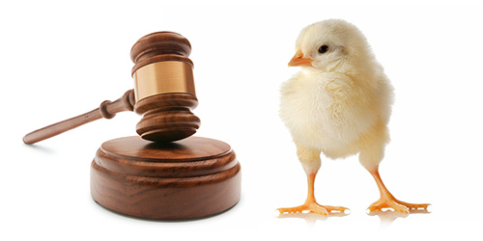
“human species-level narcissism, genetic selfishness, and conceptual pathology together conspire to make mankind’s resistance to animal rights somewhere between difficult to practically impossible” (Bartlett 2002, 170).

Slide 9
Animal ‘Moral’ Rights: Ethics & Philosophy
Dominant ideology in Australia: some harm to animals is justified and it is morally acceptable to kill animals for food
Speciesism: “a prejudice or attitude of bias in favour of the interests of members of one’s own species and against those members of other species” (Singer 2009, 6).
Ethic-based arguments for considering animals:
Utilitarian (see Singer 1975; 2009)
Rights-based (see Regan 1983)
Virtue-based (discussed in Waldau 2011)

Slide 10
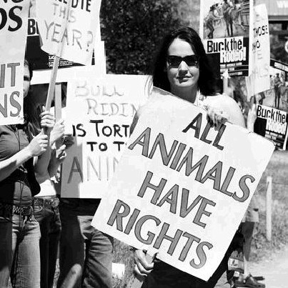
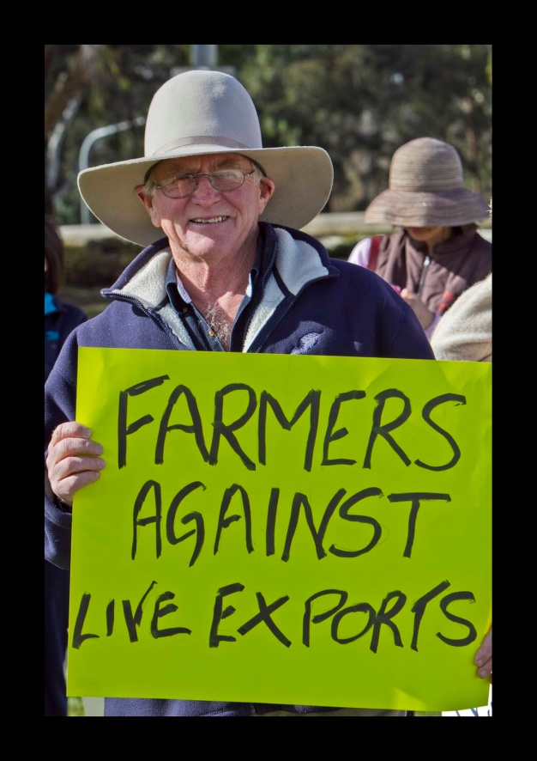
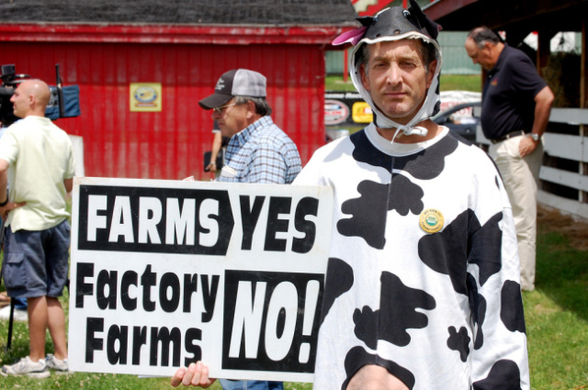
Animal Rights Activism
An ‘animal rights agenda’ informed by activist discourses is just as problematic as relying on legal discourses.

Slide 11
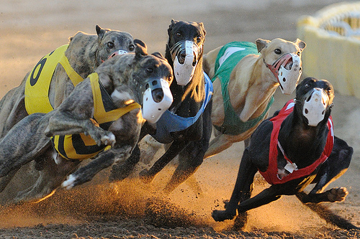
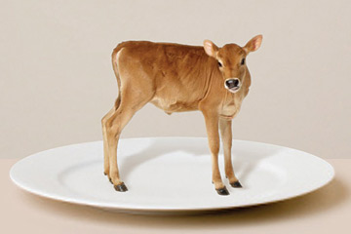
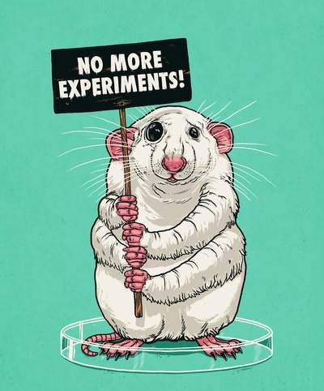
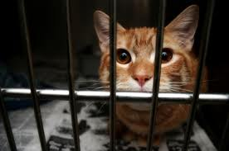
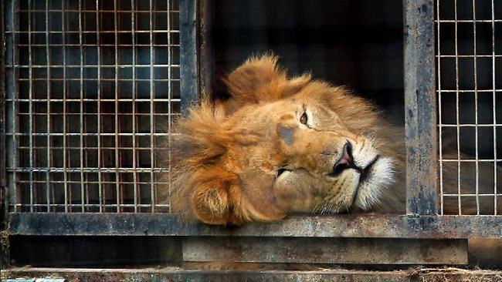
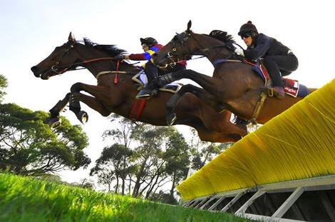
Conclusion
The future of Green Criminology?

Slide 12
Thank you.

Slide 13
References
Animal Care and Protection Act (Qld). 2001.
Ascione, Frank R. (1993). “Children who are cruel to animals: A review of research and implications for developmental psychopathology”, Anthrozoos: A Multidisciplinary Journal of the Interactions of People & Animals 6(4): 226-247.
Bartlett, Steven J. (2002). “Roots of human resistance to animal rights: psychological and conceptual blocks”. Animal law 8:143-167.
Beirne, Piers. (2006). “For a nonspeciesist criminology: animal abuse as an object of study”. Criminology 37(1): 117-148. Accessed February 07 2013. DOI: 10.1111/j.1745-9125.1999.tb00481.x
Beirne, Piers. (2011). “Animal abuse and criminology: introduction to a special issue.” Crime, Law and Social Change 55(5): 349-357. Accessed September 18, 2012. DOI: 10.1007/s10611-011-9306-5
Bjorkdahl, Kristian. 2012. “The rhetorical making of a crime called speciesism: the reception of ‘Animal Liberation’”. In Eco-Global Crimes: Contemporary Problems and Future Challenges. Edited by Rune Ellefsen, Rahgnhild Sollund and Guri Larsen. Ashgate Publishing Ltd. E-book. http://qut.eblib.com.au.ezp01.library.qut.edu.au/patron/FullRecord.aspx?p=1028883&echo=1&userid=TSMP1JmcBJLEiuKiAViwtQ%3d%3d&tstamp=1362523041&id=96DB40E92359C7BEB43A4EAB9B03F955ACEFD176
Bourke, Deidre. 2009. “Chapter 6: The use and misuse of ‘rights talk’ by the animal rights movement”. In Animal Law in Australasia, Edited by Sankoff, Peter and Steven White. Sydney: Federation Press.
Francione, Gary. (2010). "Animal Welfare and the Moral Value of Nonhuman Animals", Law, Culture and the Humanities, 6(1): 24-36. DOI: 10.1177/1743872109348989
Gullone, Eleonora. (2012). Animal Cruelty, Antisocial Behaviur, and Aggression. Basingstoke: Palgrave Macmillan.

Slide 14
References
Regan, Thomas. (1983). The Case for Animal Rights. United States of America: University of California Press.
Sankoff, Peter. (2009). “The welfare paradigm: Making the world a better place for animals?” in Animal Law in Australasia, edited by Peter Sankoff and Steven White, 7-34. Sydney: The Federation Press.
Singer, Peter. (1975). Animal Liberation: The Definitive Classic of the Animal Movement. United States of America: HarperCollins Publishers.
Singer, Peter. (2009). “Speciesism and moral status.” Metaphilosophy 40(3-4): 567-581. DOI: 10-1111/j.1467-9973.2009.01608.x
South, Nigel, Avi Brisman and Piers Beirne. (2013). “A guide to green criminology.” In Routledge International Handbook of Green Criminology, edited by Nigel South and Avi Brisman, 27-42. Abingodn, Oxon: Routledge.
Waldau, Paul. (2011). Animal Rights: What Everyone Needs to Know. United States of America: Oxford University Press.
All images on PowerPoint, found through Google image search engine.

