Slide 1
The role of Regulatory Frameworks and Non-State Actors in Creating Sustainable Diets
Photo taken by Fair Food Brisbane at Jane St Community Garden in West End
Notes:
Thank you X for the introduction.
This is a photo of a dinner I helped organize with the non-for-profit group Fair Food Brisbane. The dinner used produce from the Jane Street Community Garden in West End, was prepared by an adventurous Brisbane chef and eaten just metres from where it grew. Mainly, it was a celebration of the connections between gardens and sustenance, growers and eaters. It was at this event, and other dinners we have since held in community gardens, that has drawn my attention to the link between human and environmental health. With this connection in mind, what we eat is key to living within our ecological limits.
Today I will talk about the growing recognition of sustainable diets at international governance levels and how this reflects the challenges and win-win opportunities of living within our ecological limits. Accordingly, I will assert that sustainable diets provide an example of how living within our ecological limits would actually make us better off even apart from environmental benefits. After determining whether Australians’ generally have a sustainable diet, I will outline how Australian regulators are attempting to address sustainable diets. I will argue that the personal responsibility approach coupled with the focus on preventing or reducing overweight and obesity levels are proving incapable of bringing about long-term sustainable diets that will contribute to the health and well-being of Australian people.

Slide 2
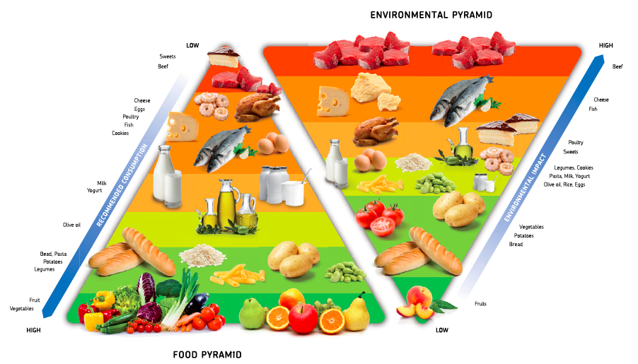
‘Double Pyramid: Healthy Food for People, Sustainable Food for the Planet’ (Barilla Center for Food & Nutrition, 2011).
Notes:
The unintended consequences of industrial food production provide well-recognised features of our global society: environmental degradation, harmful release of greenhouse gas emissions, food borne diseases, obesity and starvation. For example, it has been estimated that 25 percent of the emissions produced by people in developed countries can be traced to the food they eat. As people have become disconnected to food production and consumption, this has condoned eating practices that foster illness, alienation, injustice and degrade the environment, animals and people.
This is the Barilla Double Pyramid. It provides a unified model of the connection between human and environmental health and well-being. While many studies and government documents provide a similar conclusion, this is a clear illustration of how the foods we are advised to eat more of are generally those with the lowest environment impacts, while those foods we are advised to eat less of are commonly those with the greatest environmental impact.
Consequently, sustainable diets provides us with a wonderful lens for realising the synergies between well-being and living within our ecological limits.

Slide 3
Sustainable diets are “…those diets with low environmental impacts which contribute to food and nutrition security and to healthy life for present and future generations. Sustainable diets are protective and respectful of biodiversity and ecosystems, culturally acceptable, accessible, economically fair and affordable; nutritionally adequate, safe and healthy; while optimizing natural and human resources”.
‘Sustainable Diets and Biodiversity: Directions and Solutions for Policy, Research and Action’ (FAO: Nutrition and Consumer Protection Division, 3 November 2010) 1
Notes:
In 2010, United Nations convened a Symposium entitled “Biodiversity and Sustainable Diets”.
Definition of a sustainable diet was accepted by participants at the Conference and so at the international level, sustainable diets are “…those diets with low environmental impacts which contribute to food and nutrition security and to healthy life for present and future generations. Sustainable diets are protective and respectful of biodiversity and ecosystems, culturally acceptable, accessible, economically fair and affordable; nutritionally adequate, safe and healthy; while optimizing natural and human resources”.
I suggest that five specific components to a sustainable diet exist, based on an analysis of the literature and empirical studies.
A sustainable diet is:
Plant-based not meat-based
An extensive body of work shows that meat-based diets require more energy, land and water resources than a plant-based diet
Moreover, epidemiological studies generally find that vegetarian and low-meat diets are associated with, for example, reduced risk of diseases including cancer, coronary heart disease and diabetes.
Unprocessed, minimally processed or processed in a resource- efficient manner
Evidence has long revealed a strong causal link between the rates of inexpensive, energy-dense, processed food consumption to the rates of poverty, food insecurity, obesity and environmental degradation
Plant diverse
Tt is widely agreed that the industrial agriculture practice of limiting crop and animal breeds for mass production has resulted in the degradation of biodiversity, including species loss and the simplification of human diets
Culturally appropriate, safe and tasty:
5. Secure: in terms of being stable, available, accessible and used in a beneficial way for health and environment.

Slide 4
Is the average Australian diet sustainable?
Average Australian Diet:
Relies on foods with the highest environmental impact
Consists of comparatively high levels of manufactured or processed foods
Does not support biodiversity or micronutrient sufficiency
Disengages with Indigenous food culture “Bush foods”
Potentially insecure
Notes:
By way of application of these components, I determined that the average Australian diet is unsustainable- example of Australians not living within their ecological limits.
Australia does not meet recommended vegetable or fruit consumption levels, and is one of the top meat- consuming countries.
Australians consume comparatively high levels of manufactured or processed foods: Each year the Australian food industry is importing a larger volume of food ingredients and processed foods.
Australian diets do not support biodiversity or micronutrient sufficiency: e.g. Australian Nutrition Surveys consistently reveals insufficient intake of foods from the key food groups is widespread. 1995 nutrition survey showed that half of males aged 12 to 44 and one third of children had inadequate consumption of iron, zinc, magnesium and calcium.
Australian eating patterns disengage with Indigenous culture: Australia does not have a national cuisine. Yet, Indigenous foods are generally healthy and sustainable- native to Australia, low waste.
Australian diets may not be food secure: Yes, Australia has adequate quantities of high-quality food when supplied by both domestic production and imports. But food security is a broader concept that incorporates stability and the use of food. A growing body of work acknowledges that Australia will have increasing levels of food insecurity caused by climate change driven disruptions in supply chain.
A recent, critical piece of work by Ramsey and others involved a mail survey in disadvantaged suburbs of Brisbane. It found that one in four households were food insecure. In this context, food insecurity was strongly associated with a lack of money to buy food. Food insecurity specifically was found to be causally related to poorer general health, increased risk of depression and more frequent hospitalisations.

Slide 5
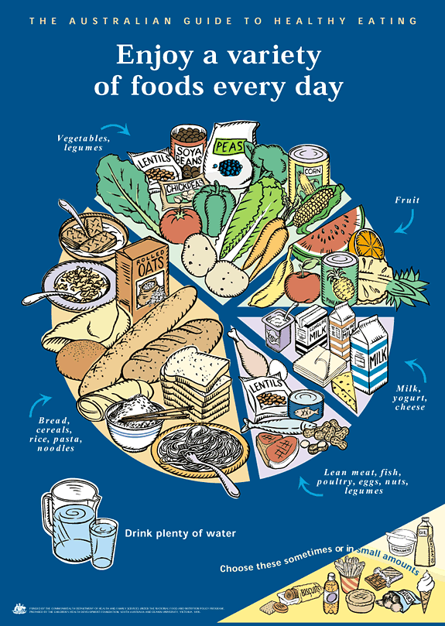
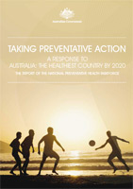
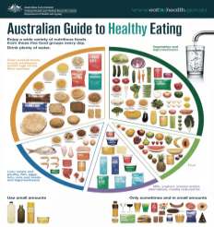
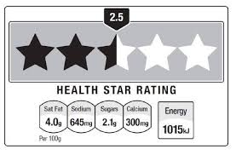
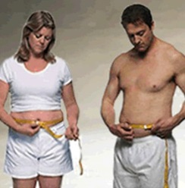
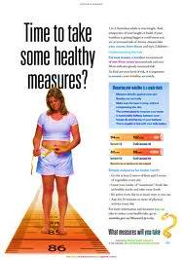
Regulatory Responses
Marketing Campaigns
2. Creating public-private collaborative approaches
3. Commissioning research reports
Notes:
In response to unsustainable dietary patterns the Australian government has created or commissioned numerous reports, initiatives and public campaigns generally targeting overweight or obese individuals:
Example of Marketing campaigns:
Marketing campaign ‘Measure up’ started in 2010, aimed at 25-50 year olds, based on evidence that weight around the waist can impact health. Has the objective of providing information about maintaining a healthy weight + providing easy to follow tips and guidelines to help people reduce their waist measurement.
“Swap it Don’t Stop It” campaign: features a blue balloon man whose belly as ballooned. He is swapping things for ‘healthier choices’ to, in Eric’s words, ‘loose my belly without losing all the things I love’. Basically promotes lifestyle choices that are based around eating less, eating home-made food and doing physical exercise.
Example of public-private collaborative approaches:
Food and Health Dialogue- non-regulatory medium for collaborative action between Government and leading food manufactures and retailers- agreed to set targets to reduce salt in particular products.
Example of research reports commissioned:
Report was released, entitled Labelling Logic: Review of Food Labelling law and Policy (2011) by an expert government-funded panel.
The report noted that ingredient lists did not align with dietary guidance as, for example, palm oil falls under a kind of vegetable oil, and is unhealthy and environmentally destructive, while other vegetable oils may be nutritious and sustainably produced, so ingredients needed to be clearer. Other recommendations included that: Australia adopt front-of-pack, traffic light system (‘FoPL’).
While initially in support of FoPL, this support was reduced to noting that FoPL may be useful, but industry concerns over market intervention should be recognised. So the Government stated that it did not want to consider FoPL at this point in time until a level of consensus would be reached amongst stakeholders.

Slide 6
“But think how comforted Australians would be in knowing their starvation diet of hand-harvested native grass seeds, packaged and processed using only renewable energy and recycled paper, is actually solving all the world’s problems as they eat ”
- Mike Keoh, Opinion Piece, ‘There’s major beef over Dietary Guidelines’, The Sydney Morning Herald, 20 November 2011
Notes:
There has been one specific development in relation to sustainable diets.
The 2011 draft of the Australian Dietary Guidelines included an appendix entitled Australian Dietary Guidelines through an Environmental Lens. It provided a brief background on sustainable dietary patterns, how to figure out environmental impact of particular food products and practical guidelines (such as eat less highly processed foods and storing food to avoid waste).
It outlined that, “Consuming a wide variety of foods may also help to ensure that an adequate variety of foods remains available in the future”. This draft provided that, “The interaction between dietary advice, the environment and food production raise cross-sectoral issues including the impact of food choices and future food security”.
During 2012, responses to the draft were submitted. Farming groups had largely a negative response to the draft.
For example, I have a quote from a representative of National Farmers Federation up on this slide. Their arguments tended to be that the drafters had based their information on experts in public health, epidemiology and physics as opposed to agricultural scientists.
Supporters of the draft appendix included: Dieticians Association of Australia and the Cancer Council/

Slide 7
“Health, food choices and environmental consequences can all be influenced by behaviour change. Discussing sustainability in the context of consumption habits not only has the potential to improve population health but also supports the objective of achieving a sustainable food supply with improved food security”
Australian Dietary Guidelines, 2013.
Notes:
After these submissions + the beginning of this year, the final Australian Dietary Guidelines were released.
Appendix G is entitled “Food, nutrition and Environmental Sustainability”. It advises Australians to choose foods for health and sustainability and argues that “Eating nutrient-dense foods…provide health benefits and reduce the environmental impact associated with foods”. Subsequently, the Appendix acknowledges that “Discussing sustainability in the context of consumption habits not only has the potential to improve population health but also supports the objective of achieving a sustainable food supply with improved food security”. No guidance on sustainable foods or dietary patterns is provided as the practical tips and guidelines were removed from the final version.

Slide 8
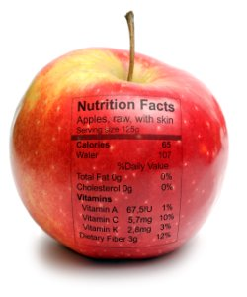
The Australian Regulatory response distracts from the broader structural Issues
Notes:
Now, I’m going to critique the Australian regulatory response under three arguments.
The first argument is that the Australian regulatory response distracts from the broader structural issues:
The approach of Australian regulators has been to promote exercise and a lower food energy intake to a general audience. Conventional wisdom and research generally holds that overweight and obesity results from an energy imbalance- too many calories in and not enough burnt.
This simple, arguably mechanistic, equation has been doubted.
A large body of work suggests that obesity is caused by interactions between a diverse range of factors including: pharmaceutical-induced weight gain; sleep debt; central heating and cooling; and industrial chemicals.
An essential body of work is examining the ‘causes of the cause’. The claim is that economic growth, malnutrition, obesity and environmental sustainability are linked. The core argument is that economic growth is subject to diminishing returns. This means that economic growth is said to reach a point where it is supporting health and well-being of people and planet, but then grows so high that it produces overconsumption problems such as obesity or unsustainable carbon footprints
As a consequence of their individual based, energy in/out model, the Australian government, legal and policy discourses, and more generally society at large has provided a simplified message about health and well-being. This creates a major obstacle for consumers when making truly informed choices

Slide 9
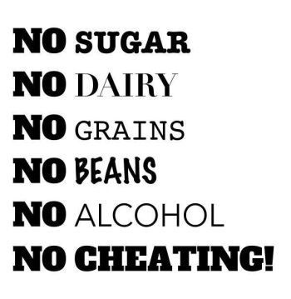
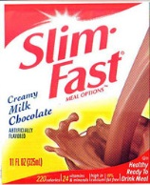
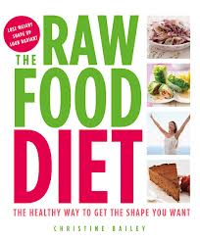
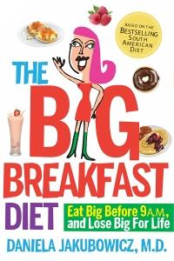
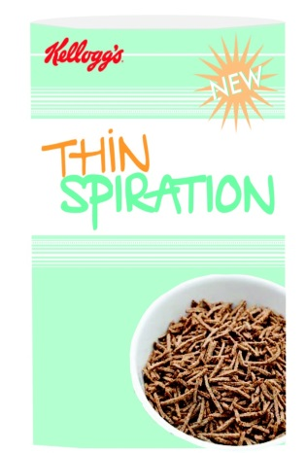
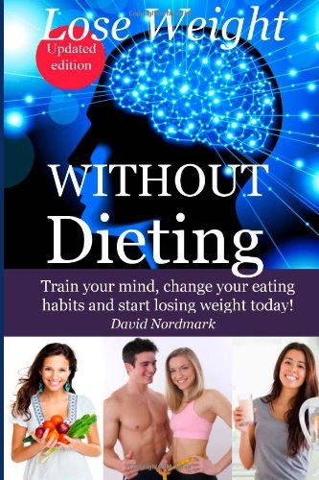
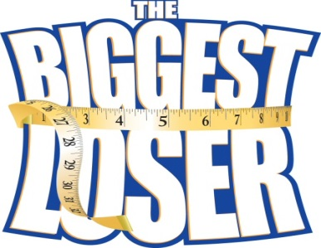
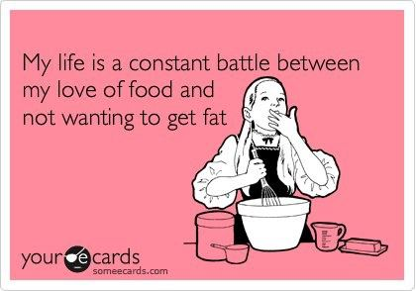
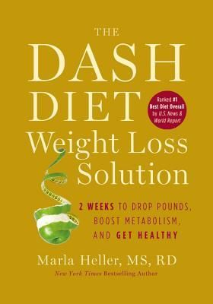
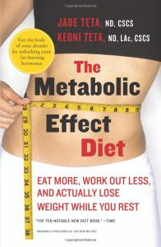
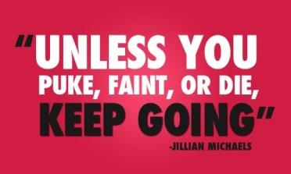
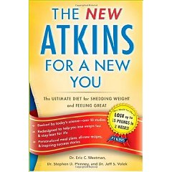
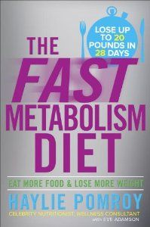
2. The Australian regulatory response fosters an unhealthy, alarmist obsession with weight
Notes:
The second argument is that the Australian regulatory response fosters an unhealthy, alarmist obsession with weight
Growing body of work, sourced in various disciplines, has been critiquing the alleged obesity epidemic.
The work in this area questions both the existence of an obesity epidemic and its causal links to disease and mortality. A key argument is that the available data on overweight and obesity is based on body mass index, which is a highly criticized tool in medical literature. Another common critique regards the causal links between obesity, morality and disease as weak and relying on questionable assumptions. Some medical studies suggests that patients who are overweight or moderately obese have survival advantages. Alongside this focus on defective science, historical researchers examined the history of overweight and obesity, and concluded that, while excess body weight and fatness not new, the obsession at political, social and economic levels with health, weight and obesity is new.
Guthman has extensively criticised the focus on overweight and obesity, and argued that it results in: ‘missionary like interventions’; aggravated social inequalities and “impossible, unachievable standards for economic, biological and political competence in today’s world”.
Regardless of whether these viewpoints are accurate, the pervasiveness of the stigma surrounding overweight and obesity has been confirmed by an extensive, international and quantitative analysis of attitudes towards overweight and obesity. In fact, an extensive international study found that overweight and obese people are, in general, openly stigmatized more than racism, sexism and other types of bias.

Slide 10
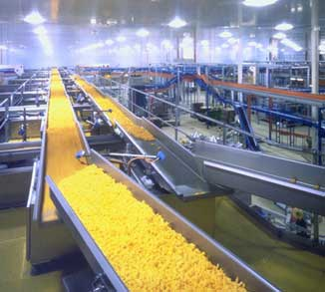
Example: Goal 12 from National Food Plan White Paper 2013 “Australians will have the information they need to help them make decisions about food”
Pathway to achieving this:
“Support industry-initiated self-regulatory and co-regulatory approaches to labelling of food in relation to consumer values issues” (Page 96)
3. Australian regulators are resistant to regulating the food industry in relation to shifting dietary patterns
Notes:
Moving on to the third argument which is that the Australian regulators are resistant to regulating the food industry in relation to shifting dietary patterns.
In general, Australian regulators favour a voluntary self-regulation approach to regulating the food industry. It positions the food industry as part of the solution along with an emphasis on obesity prevention through physical activity, personal and corporate responsibility and other government initiatives. Moreover, Australian regulators have actively sought collaborations with food companies, which approach suggests that food industry can be persuaded to market ethically and create sustainable products.
Yet, these kinds of approaches may be set to fail because corporations are legally required to have the goal of growing in profits not the goal of growing in profits and providing sustainable, healthy food products. In other words, the goals of corporations are at odds with the need for Australian society to move towards a sustainable diet and, in general, to live within ecological limits. Perhaps as a result of this inherent conflict, a growing body of evidence suggests that transnational companies are not following their own codes for sustainability and health and lack monitoring and enforcement mechanisms.
Additionally, commentators are pointing to tobacco and asbestos companies and arguing that the food industry is employing the same strategies to slow or thwart formal, binding regulations. These strategies include: creating bias research findings, lobbying politicians and public officials to oppose public regulation; creating fears around ‘nanny state’ governments and emphasising individual responsibility.

Slide 11
Conclusion
www.fairfoodbrisbane.org
https://www.facebook.com/Fairfoodbne
Notes:
Sustainable diets are a key strategy for living within our ecological limits.
Effectively, the Australian regulatory responses begin with the viewpoint that Australian diets are creating significant issues that is to be addressed by profoundly altering the way Australian people live. However, these claims do not engage with the broader sustainability issues or the complexity of human bodies and their environment. These simplistic claims are then slowly back away from by interventions doing little more than creating marketing campaigns and emphasising public-private collaborations that aim to instigate narrow lifestyle interventions on individual behavior. Moreover, Australian regulators appear influenced by the strategies adopted by the food industry, such as, lobbying by industry groups and fears of paternalism. Accordingly, the policy documents give the appearance of a legitimate, stern response that is actually a thin veneer covering legally binding solutions that may be politically unpopular in terms of particular farming and industry groups as well as society at large.
A starting point is to move the discussion surrounding policy and legal responses to obesity away from an excessive focus on weight loss and personal responsibility. This would require recognition that weight does not equate to health and the humble acceptance that health, the human body and the environment are far more complex and profoundly linked than is comprehensible. Moreover, future approaches should take advantage of the win-win opportunities inherent in living within our ecological limits.
Thank you for listening.

