Slide 1
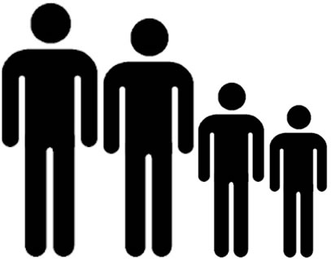
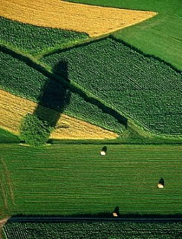

CARRYING CAPACITY
…the maximum number of people that an area of land (locally) can support.
÷
Population carrying capacity
=
Productive land
Productive land per person
Notes:
PhD in carrying capacity – produced model.
Basis of research – smaller scale self sufficiency in future – resource constraints brought on by peak oil, ever-increasing populations and climate change
Demographics – resource consumption – commodities – ag land yields + land use availability = cc

Slide 2
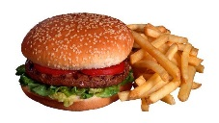
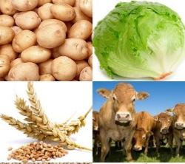


CARRYING CAPACITY
…the maximum number of people that an area of land (locally) can support.
Consumption habits (local)
÷
  ➔
Population carrying capacity
Short-distance
=
  ➔
quantity
Productive land
Productive land per person
Production yields (local)
Notes:
PhD in carrying capacity – produced model.
Basis of research – smaller scale self sufficiency in future – resource constraints brought on by peak oil, ever-increasing populations and climate change
Demographics – resource consumption – commodities – ag land yields + land use availability = cc

Slide 3
CARRYING CAPACITY
…the maximum number of people that an area of land (locally) can support.
Consumption habits (local)
÷
  ➔
Population carrying capacity
Short-distance
=
  ➔
quantity
Productive land
Productive land per person
Production yields (local)
ECOLOGICAL FOOTPRINT
…the amount of land (globally) each person requires.
  ➔
Consumption habits (local)
÷
Long-distance
  ➔
=
quantity
Population
Productive land per person
Productive land
Production yields (global)
Notes:
PhD in carrying capacity – produced model.
Basis of research – smaller scale self sufficiency in future – resource constraints brought on by peak oil, ever-increasing populations and climate change
Demographics – resource consumption – commodities – ag land yields + land use availability = cc

Slide 4
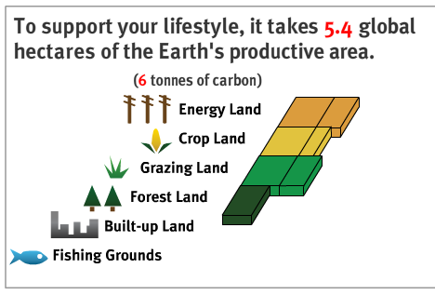
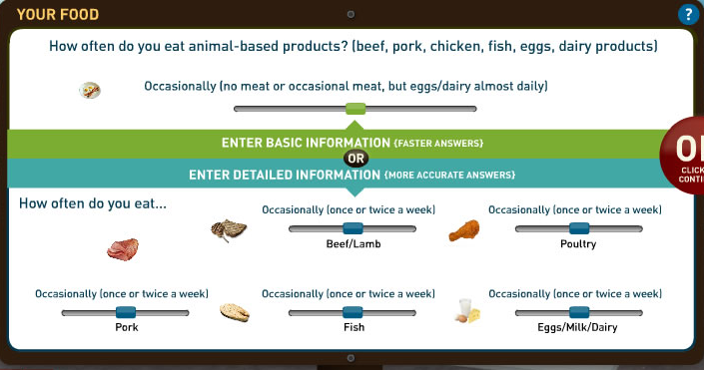
Ecological footprint interface
(appropriated carrying capacity)
- Input: local consumption choices
global production
- Output: land usage (global hectares)
http://www.footprintnetwork.org/en/index.php/GFN/page/calculators/

Slide 5
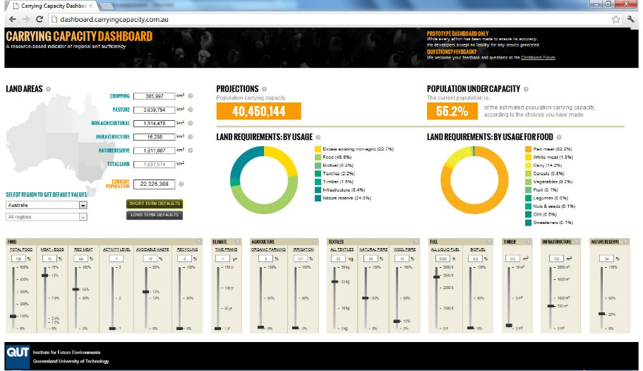
Ecological footprint interface
(appropriated carrying capacity)
- Input: local consumption choices
global production
- Output: land usage (global hectares)
Carrying capacity interface
- Input: local consumption choices
local production
- Output: population & land usage
http://www.footprintnetwork.org/en/index.php/GFN/page/calculators/

Slide 6
Ecological footprint interface
(appropriated carrying capacity)
- Input: local consumption choices
global production
- Output: land usage (global hectares)
Carrying capacity interface
- Input: local consumption choices
local production
- Output: population & land usage
http://www.footprintnetwork.org/en/index.php/GFN/page/calculators/

Slide 7

INPUTS
Basic needs
Time-scales
Space-scales

Slide 8
FOOD: amount, meat-eggs, red meat, activity level, avoidable waste, recycling
CLIMATE VARIABILITY, AGRICULTURE: organic farming, irrigation
TEXTILES: amount, natural fibre, wool
FUEL: liquid fuel, biofuel
TIMBER, INFRASTRUCTURE, NATURE RESERVE
INPUTS
Basic needs
Time-scales
Space-scales

Slide 9
INPUTS
Basic needs
Time-scales
Space-scales
Short-term defaults

Slide 10
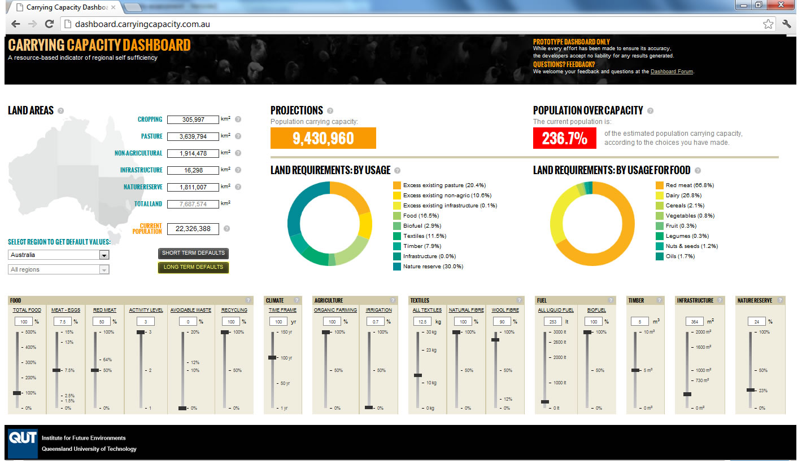
Long-term defaults
INPUTS
Basic needs
Time-scales
Space-scales
LESS:
- meat
- wastage
- liquid fuel
- infrastructure
MORE:
- physical activity
- recycling
- organics
- timeframe
- natural textiles
- biofuel
- timber
- nature reserve

Slide 11
INPUTS
Basic needs
Time-scales
Space-scales

Slide 12
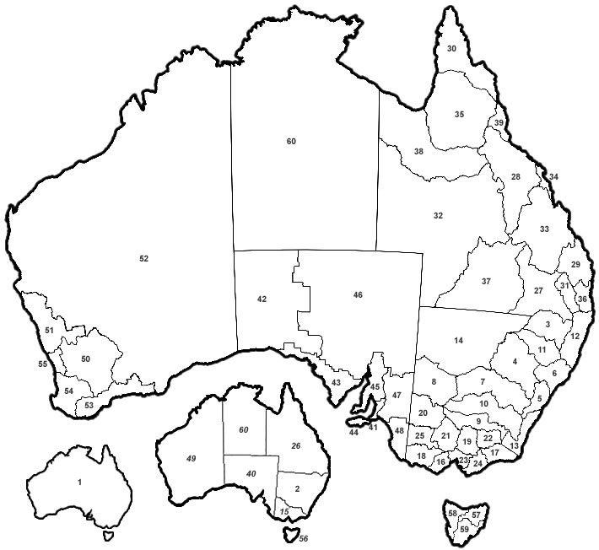
INPUTS
Basic needs
Time-scales
Space-scales

Slide 13
OUTPUTS
Population
Land use

Slide 14
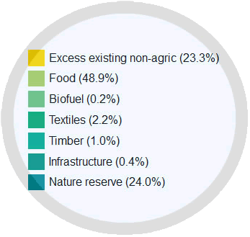
OUTPUTS
Population
Land use

Slide 15
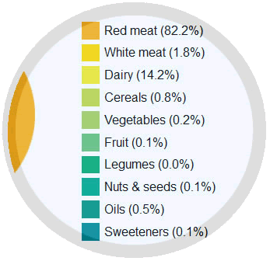
OUTPUTS
Population
Land use

Slide 16
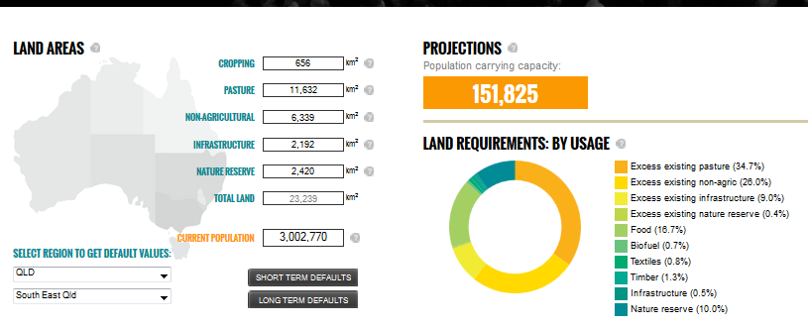
Notes:
THE reason for this discrepancy is the efficiency of land-use in either instance.
UNDER small-scale circumstances there’s likely to be more land under-utilised because once all the cropping land is used in each region, carrying capacity is reached regardless of how much pasture land might still be available.
OF course, it is possible that regions might use that pasture land and trade the animal products or alternatively, local populations could adjust their resource consumption habits, such as their diet, to reflect the productive nature of their local landscapes.
SO potentially, the dramatic differences indicated here may be altered somewhat, but it still holds true that complete regional self sufficiency is likely to lead to a smaller overall carrying capacity.

Slide 17
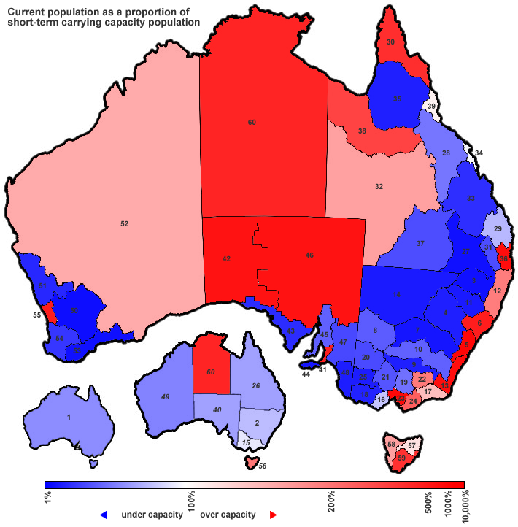
POPULATION distribution
Under capacity
Over capacity
Notes:
If self sufficient at this diet and this land use and at this scale – implies relocation of the population
But long-term – no where to go

Slide 18
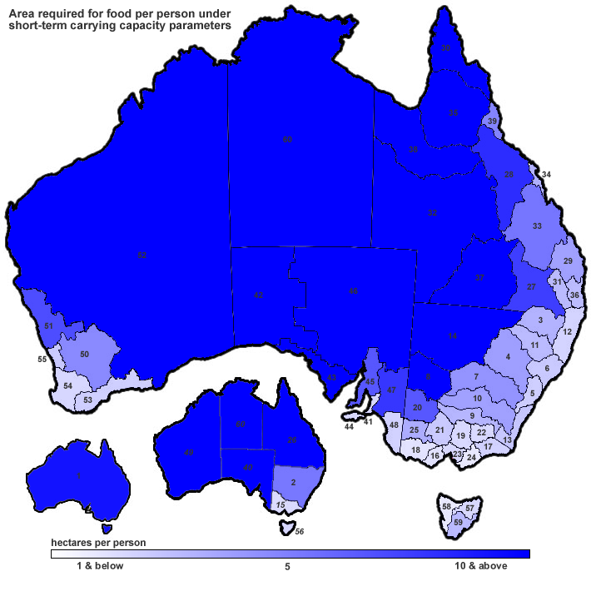
LAND productivity
Land for food production (hectares per person per year) | Aust. | SEQ
Standard Australian diet | 9.3 | 2.5
Vegetarian diet | 1.7 | 0.6
Vegan diet | 0.3 | 0.2
Food consumption - diet
2.5 LOCALISED hectares
= 250m x 100m
= 3.7 rugby league fields
(just for food per person)
Annual consumption per person for standard Australian diet
Food production - land
Annual production per person for standard Australian diet
Notes:
Productivity of regions with current diet and land use.
Help to clarify how much land is actually needed per person for different diets – a lot of disagreement – this is conventional ag.

Slide 19
LAND productivity
Land for food production (hectares per person per year) | Aust. | SEQ
Standard Australian diet | 9.3 | 2.5
Vegetarian diet | 1.7 | 0.6
Vegan diet | 0.3 | 0.2
Food consumption - diet
Annual consumption per person for standard Australian diet
Food production - land
Annual production per person for standard Australian diet
27
Notes:
Productivity of regions with current diet and land use.
Help to clarify how much land is actually needed per person for different diets – a lot of disagreement – this is conventional ag.

Slide 20
LAND productivity
Land for food production (hectares per person per year) | Aust. | SEQ
Standard Australian diet | 9.3 | 2.5
Vegetarian diet | 1.7 | 0.6
Vegan diet | 0.3 | 0.2
Food consumption - diet
Annual consumption per person for standard Australian diet
Food production - land
Annual production per person for standard Australian diet
27
Notes:
Productivity of regions with current diet and land use.
Help to clarify how much land is actually needed per person for different diets – a lot of disagreement – this is conventional ag.

Slide 21
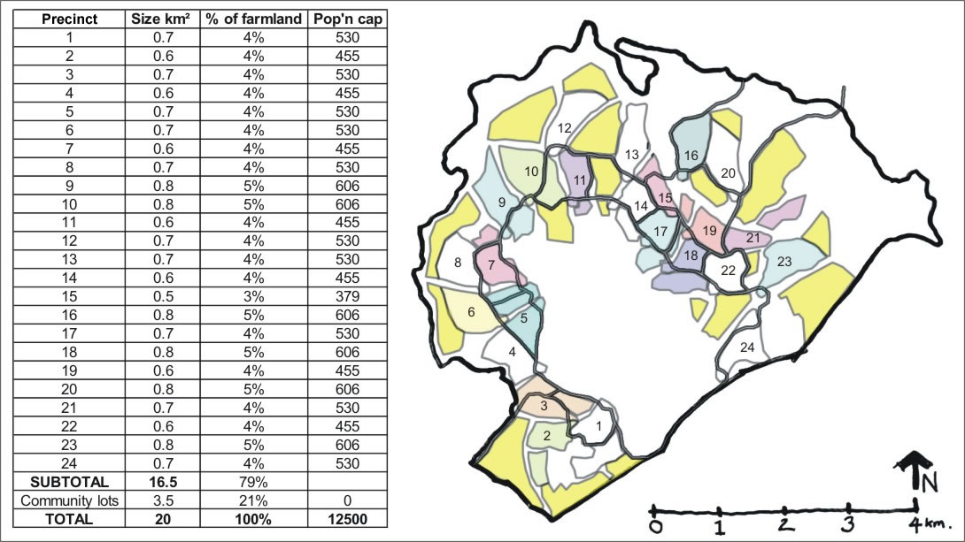
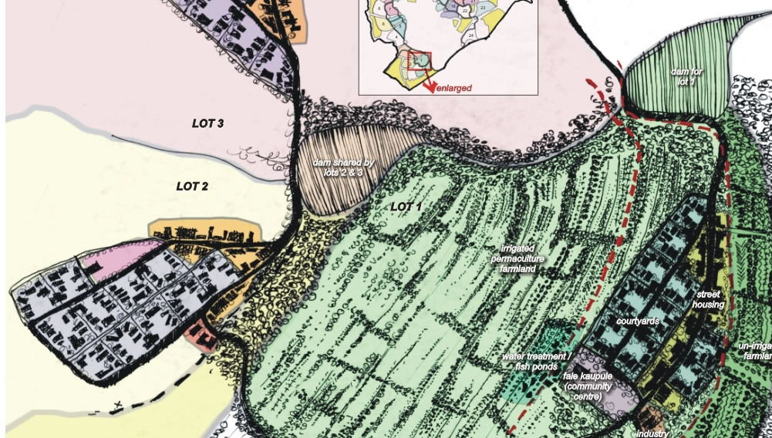
CARRYING CAPACITY land-use
http://tuvalu7seas.com/

Slide 22
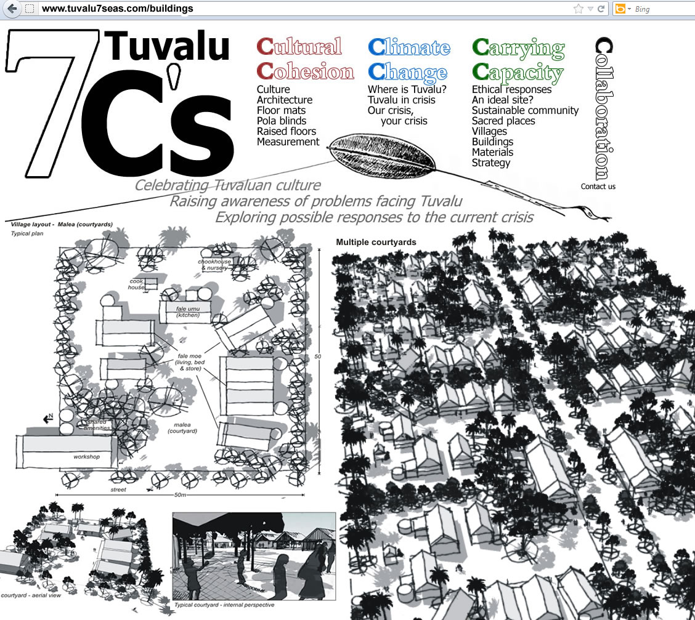
Notes:
Close-nit sense of community with an acknowledgement that we are entirely reliant on our natural environment so we need to treat it with care.

