Slide 1
The EArTh’s ecological limits and the myth of endLESs growth
Ian Lowe

Slide 2
The inconvenient truth
Current human consumption is well beyond the Earth’s ecological limits
Further growth will worsen our situation
The delusion of unlimited growth is incompatible with the goal of a sustainable future , i.e. one that could be sustained for the foreseeable future

Slide 3
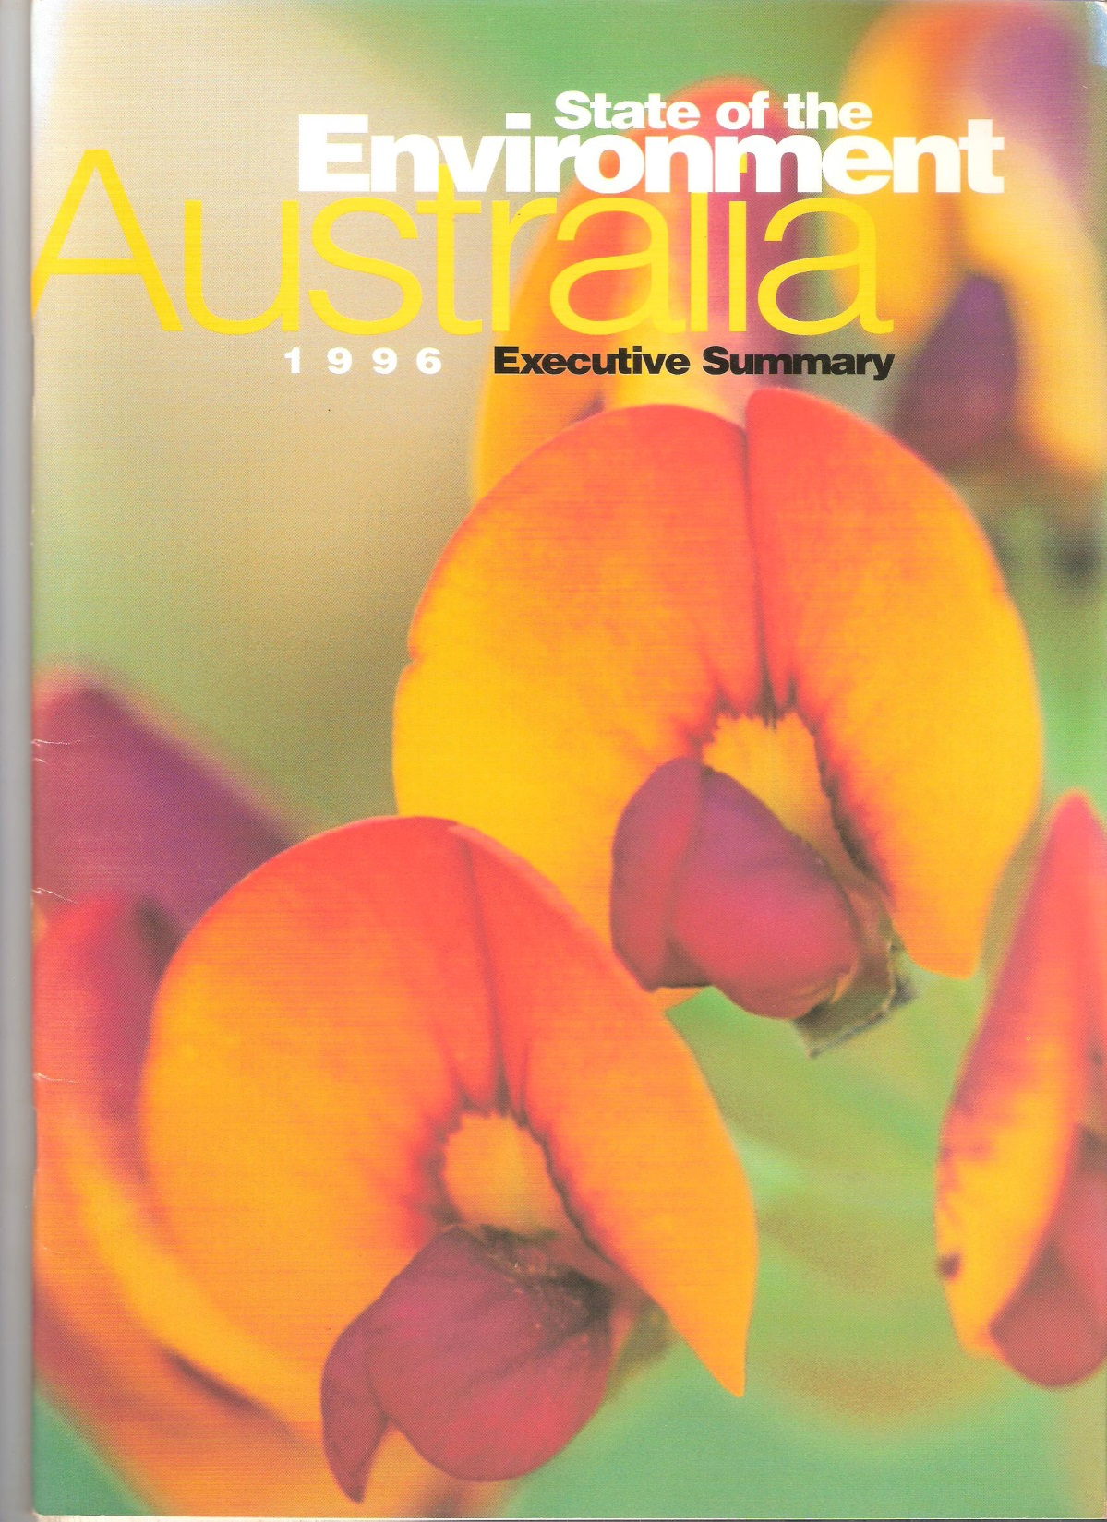

Slide 4
The conclusion, SoE 1
“Australia has some very serious environmental problems. If we are to achieve our goal of ecological sustainability, these problems need to be dealt with immediately.
“The problems are the cumulative consequences of population growth and distribution, lifestyles, technologies and demands on natural resources”

Slide 5
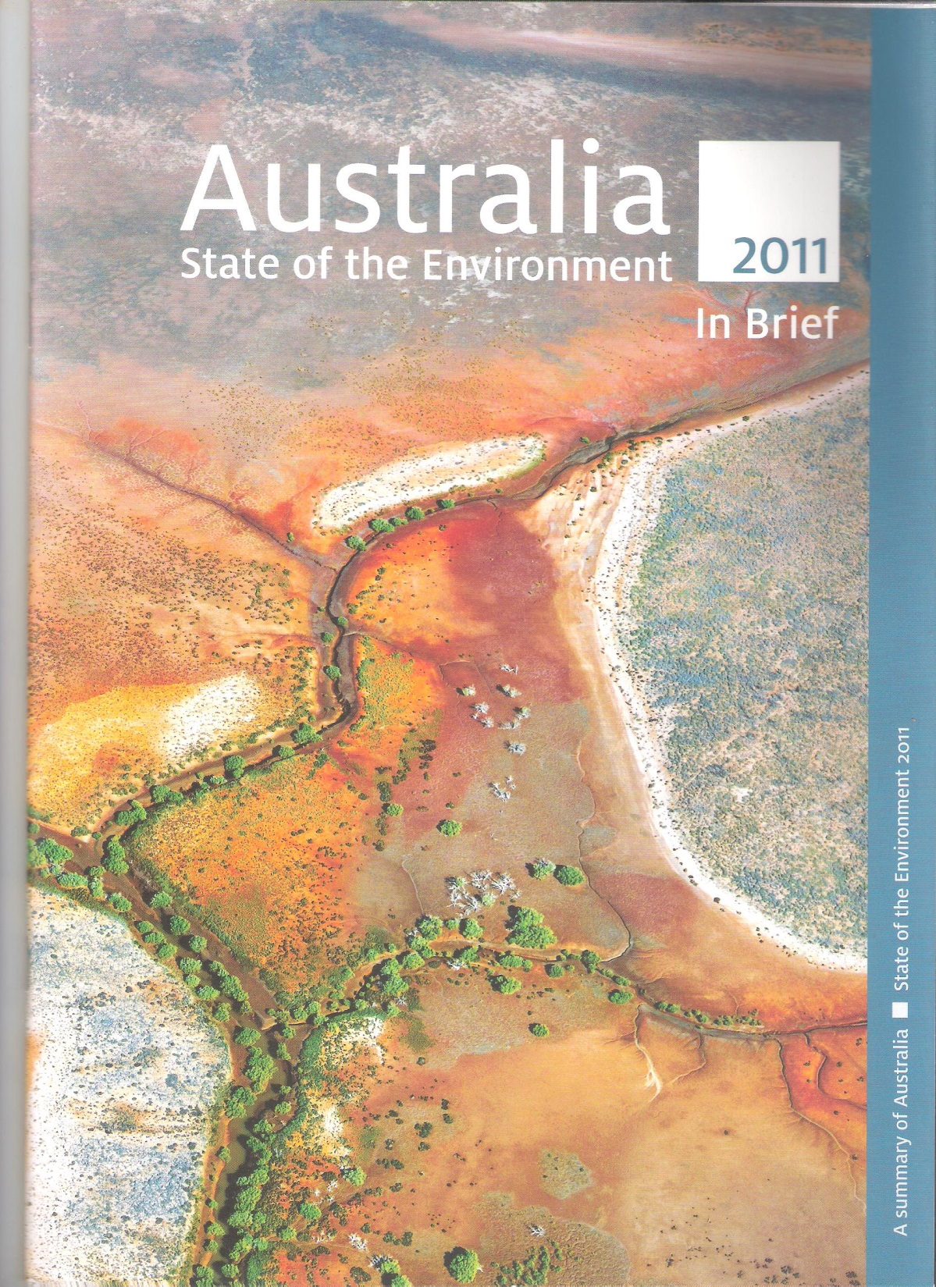

Slide 6
The update
“Much of Australia’s environment and heritage is in good shape, or improving. Other parts are in poor condition or deteriorating… Our changing climate, and growing population and economy, are now confronting us with new challenges.”

Slide 7
Measures of Progress
ABS project begun in 1990
Headline indicators: economic, social, environmental
Every report shows continuous economic progress, mixed social change, all key environmental indicators worsening

Slide 8
Limits to Growth, 1972
If existing growth trends in population, resource use, agricultural production, industrial output and pollution were all to continue, the world would reach limits to growth within 100 years
Most likely result: environmental, economic and social collapse before 2050
None of these trends inevitable…

Slide 9
Our Common Future
It is possible to make development sustainable, meeting the needs of the present without harming the ability of future generations to meet their needs
“The concept of sustainable development does imply limits… limitations imposed by the present state of technology… and by the ability of the biosphere to absorb the effects of human activities”

Slide 10
GEO4: “Unprecedented environmental change at global and regional levels”
Increasing global average temperatures, widespread melting of snow and ice, and rising global average sea level
Unsustainable land use and climate change driving land degradation
Aquatic ecosystems are heavily exploited
Water availability declining globally
Almost all well-studied species declining in distribution, abundance or both

Slide 11
Loss of species diversity

Slide 12
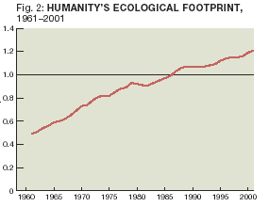

Slide 13
Likely non-linear changes
There is established but incomplete evidence that our impacts on ecosystems are increasing the likelihood of non-linear changes … with important consequences for human well – being.
Millennium Assessment Report 2005

Slide 14
An example of non-linear change
Millennium Assessment Report 2005

Slide 15
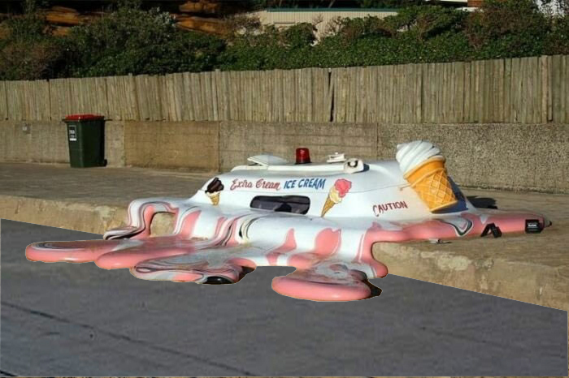

Slide 16
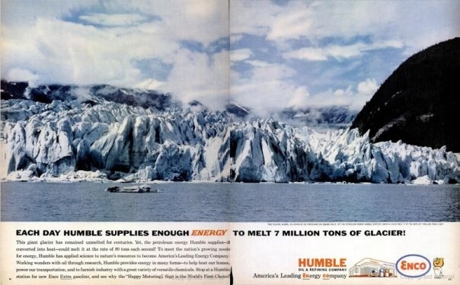

Slide 17
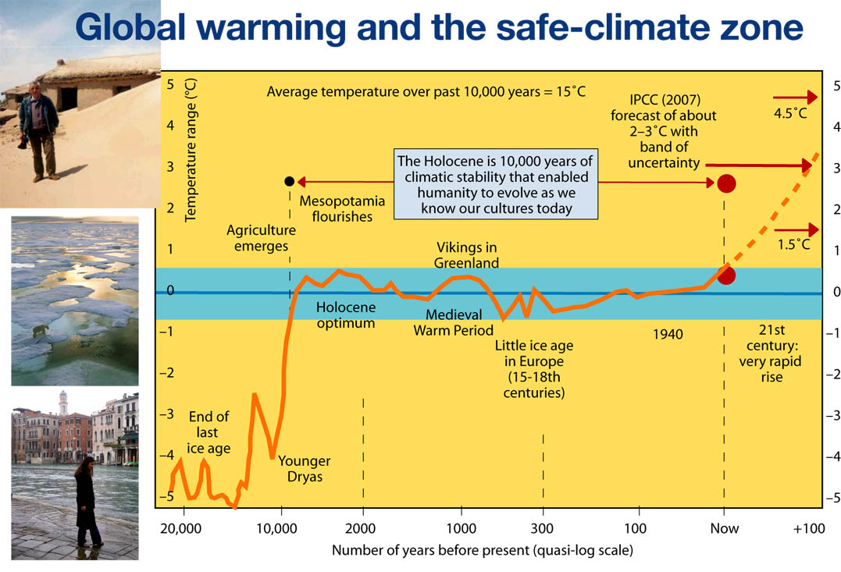

Slide 18
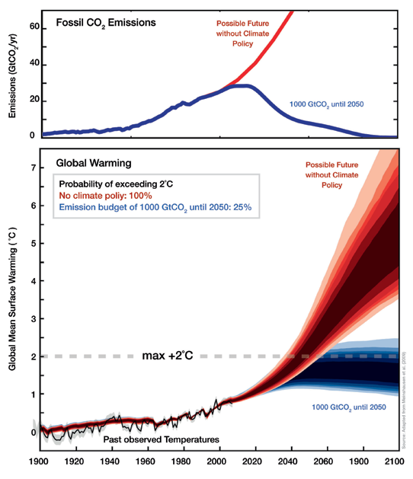

Slide 19
To have a better than even chance of keeping global average temperature rise below 2°C, the world would need to be emitting less than half the 2000 amount of CO2 by 2050.
So global emissions need to peak within the next 10 years and then decline rapidly.

Slide 20
IEA World Energy Outlook 2008
“nothing short of an energy revolution”

Slide 21
RESILIENT PEOPLE
RESILIENT PLANET
A Future Worth Choosing
THE 2012 REPORT OF THE UNITED NATIONS SECRETARY-GENERAL’S HIGH-LEVEL PANEL ON GLOBAL SUSTAINABILITY

Slide 22
Summary of key issues
Unprecedented prosperity, planet “under unprecedented stress”
> 1 billion live in poverty
Development model unsustainable
“new nexus” – food, water, energy
Need for integrated thinking
New sustainability indicators
Policy linked to science

Slide 23
15… by embracing a new approach to the political economy of sustainable development, we will bring the sustainable development paradigm from the margins to the mainstream of the global economic debate…the cost of action and the cost of inaction will become transparent.

Slide 24
RESOURCE EFFICIENCY: Economics & outlook for asia & pacific unep 2011
Ian Lowe

Slide 25
Report prepared for UNEP by CSIRO in collaboration with other research bodies in Asia-Pacific region

Slide 26
Spectacular growth
“1970 to 2005 saw the most rapid growth in natural resource use in the history of Asia and the Pacific, impelled by unprecedented economic development and progress in most of its countries”
Also “greater environmental pressures, larger greenhouse gas emissions, lower resource and energy efficiency and rising consumer waste”

Slide 27
Looming challenges
“today’s patterns of production and consumption broaching the limits of what the planet can supply and sustain”
“pressures arising from scarcity of water, land, food, nutrients, oil & strategic materials are converging rapidly”

Slide 28
The bottom line
“A new industrial revolution that uses far less energy, water and raw materials is becoming essential in the face of emerging global uncertainties in resource supply, economics, environmental change and climate change”

Slide 29
“Our present course is unsustainable - postponing action is no longer an option” - GEO 2000 [UNEP 1999]

Slide 30
Limits to Growth + 30 years data
On all key parameters [population,
resource use, industrial output,
agricultural production and
pollution] we are tracking the “standard run” which leads to economic and ecological collapse before 2050.
“No-one has to change. Survival is optional”

Slide 31
“these recent crises - fuel, food and finance - are simply the three canaries in the mine. These are the early warning signals that our current economic system is simply not sustainable.”
WEF Global Agenda Summit, 2008

Slide 32
Collapse: Jared Diamond
Societies usually expand until they reach limits
They can then choose to change, to live within those limits, or maintain practices that have caused problems
The second course leads to crisis, usually collapse

Slide 33
Why does growth myth endure?
Slaughter, Inayatullah: Causal Layered Analysis
Most discussion at Litany level
Some analysis Social Causes
Deep-seated myths and metaphors go largely un-noticed, certainly unquestioned

Slide 34
Deep-seated myths
There are no limits
Growth is inevitable and desirable
Any other problems can be solved as long as we are wealthy enough: “It’s the economy, stupid”

Slide 35
Consequent policies
“climate change is crap”
we’ll always find new resources
“green tape”
“a big Australia … the more the better”

Slide 36
Three alternative responses [Richard Eckersley]
Denial: Don’t change, instead try to prove that change is not necessary [John Kenneth Galbraith]
Avoidance: “Don’t underestimate the power of distraction” [Woody Allen]
Take responsibility for change: a small group can change the world [Margaret Mead]

Slide 37
The underlying drivers of unsustainable development
Population growth
Consumption per person
Societal values

Slide 38
New suite of values
Domination of nature becomes ecological sensitivity
Consumerism replaced by quality of life
Individualism -> human solidarity

Slide 39
“globo sapiens”
Empathy
Global consciousness
Thinking beyond our generation
Willing to embrace change
Courage !

Slide 40
Conclusion
Current human activity exceeds capacity of natural systems
Further growth makes all the problems worse
The myth of endless growth now threatens our survival
A new approach is urgent

Slide 41
a new story

