Slide 1
Providing for indigenous perspectives – New Zealand examples
Baden Vertongen

Slide 2
Introduction and glossary
Some commonly used terms:
Maori – general term for New Zealand’s indigenous people;
Iwi – ‘tribe’;
Hapu – ‘sub-tribe’;
Pakeha – European descendants;
The Crown – NZ Government;
In New Zealand indigenous rights are often described as ‘Treaty’ rights and relationships;
Refers to the 1840 Treaty of Waitangi;
Claims of ‘Treaty breaches’ can be made to the Waitangi Tribunal;
There is a policy driven ‘Treaty settlement process’ aimed at settling historical Treaty breaches.

Slide 3
Maori perspectives on the natural environment
Much more detail can be provided by kaumatua/elders. See also Waitangi Tribunal reports and evidence;
Generalisations are risky:
Different iwi and hapu will have differing traditions;
Modern iwi structures may have a range of perspectives and pressures;
Should not be seen as ‘conservationist’ principles – Maori values often mis-viewed through ‘green tinted’ lenses.

Slide 4
Maori perspectives on the natural environment
General principles include:
Whakapapa –ancestral/descent connection;
Tapu and noa – ‘scared/special’ and ‘normal’;
Kaitiakitanga – guardianship;
Mauri and wairua – natural resources/features have their own ‘life force’ or ‘spirit’;
A holistic view;
Natural features are part of defining who you are and provide a sense of place as ‘tangata whenua’;
Often clashes with legislation and Crown policies or decisions.

Slide 5
Reflecting Maori perspectives in the existing legal framework
Often some requirement to consider Maori perspectives, but:
Detail of ‘how’ varies significantly;
Over-arching purpose/aim of legislation may be the problem;
Can be just one of many other factors to consider;
Not holistic;
Decision makers are not necessarily Maori;
A number of reports by the Waitangi Tribunal on failures to provide for Maori values or input;
The Treaty settlement process can provide mechanisms for better input.

Slide 6
Outcomes of the Treaty settlement process
Apology and Acknowledgements;
Financial redress;
Cultural redress:
Return of specific sites (may use ‘tupuna’ title or be held in trust by a governance entity);
Deeds of Recognition and Statutory Acknowledgments;
Overlay Classifications;
Special redress:
Co-Management;
Legal personality for specific features;
Other;
Deed of Settlement and implementing legislation.

Slide 7
A ‘legal personality’ for a natural feature/resource
What is ‘legal personality’?
A ‘legal person’ is an entity upon which a legal system confers rights and duties;
Ability for an entity to do things and (have things done to it) in its own name is ‘legal personality’;
People are legal ‘persons’;
Other legal ‘persons’ include companies, some societies and trusts, government organisations, etc
Legal ‘persons’ operate through various agents – eg directors of a company;
Different from a trust arrangement as the duties focus on the entity rather than those with interests in it.

Slide 8
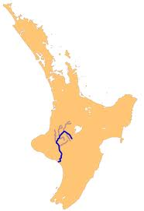

Slide 9
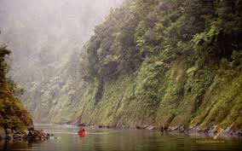

Slide 10
The Whanganui River
Claims re the Whanganui River include the longest running piece of litigation in NZ;
Relate to ownership and management (eg extraction of gavel and hydro-electric generation);
Numerous iwi and hapu have interests;
Waitangi Tribunal report in 1999 (hearings were in 93-94);
Negotiations since 2002;
‘Agreement in Principle’ reached;
A legal personality for the Whanganui River is intended to:
‘ reflect the Whanganui Iwi view that the River is a living entity in its own right and is incapable of being "owned" in an absolute sense’
Tutohu Whakatupuna dated 30 August 2012 between Whanganui Iwi and the Crown (available at www.ots.govt.nz).

Slide 11
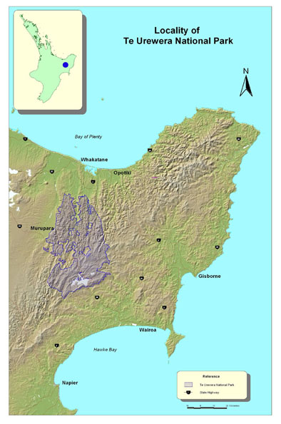

Slide 12
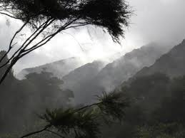

Slide 13
Te Urewera
Homeland of the Tuhoe iwi (and related iwi have interests as well);
Tuhoe suffered armed invasions by Crown forces, confiscation of land, loss of land via title investigations;
Much of this land is now a significant National Park;
Waitangi Tribunal hearings 2003-5;
Interim Tribunal reports from 2009 while negotiations were ongoing;
Negotiations stalemated over ownership of the National Park.

Slide 14
Te Urewera
Legal personality is to be developed for Te Urewera National Park:
‘Te Urewera is a place of spiritual value, with its own mana and mauri.’
‘For Tūhoe, Te Urewera is their ewe whenua, their place of origin and return, indeed their homeland’
Will be given effect to by a separate piece of legislation – a Te Urewera Act;
Deed of Settlement of Historical Claims dated 4 June 2013 between Tuhoe and the Crown (available at www.ots.govt.nz).

Slide 15
Elements of Te Urewera legal personality
‘Te Urewera’ deemed to have legal personality;
Land ownership vested in ‘Te Urewera’ (is currently Crown owned land with National Park status);
A Board established as statutory board to undertake governance and management functions;
In exercising its functions the Board may ‘consider and give expression to’ Tuhoe management concepts/principles;
Equal Tuhoe and Crown appointments to the Board and chair to be one of the Tuhoe appointees;
Range of other technical and operational provisions as well as planning and accountability requirements.

Slide 16
Why does this concept work?
Pushes comfort levels without being ‘new and scary’:
Practical outcome is not very different from existing management;
Builds on previous outcomes of the Treaty settlement process;
Reflects a Maori perspective very well:
Is a ‘person’;
Isn’t ‘owned’ – Board is not the owner, but is agent for the entity;
The Treaty settlement process is a key factor:
A degree of acceptance (or apathy) to the process;
Is focused on a specific feature not the environment generally;
Requires legislation which can be used to cut through problems.

Slide 17
What might this mean for Te Urewera?
Better incorporation of Tuhoe values;
Will duties/obligations be owed to Te Urewera itself rather than to people with an interest in Te Urewera?
For example a company director has a primary duty to the health of the company rather than shareholders. Does the same apply here?
What will ‘harms’ look like? No longer economic impact on ‘beneficiaries’ of an asset held on trust, but is an impact on the entity itself?
Is this a significant shift in how a natural feature is viewed? The full legal implications still need to play-out;

Slide 18
Places to find more information
Office of Treaty Settlements (www.ots.govt.nz)
Settlement policy guide (Healing the past; building a future)
Deeds of Settlement
Agreements in Principles (or similar)
Waitangi Tribunal (www.watangi-tribunal.govt.nz)
Reports are all online
Several deal with environmental issues
Wai 262 Flora and Fauna Report – Ko Aotearoa Tenei
Ongoing freshwater and geothermal inquiry
Evidence and research can be available from Tribunal
Co-Management of Waikato River
Deeds with Waikato-Tainui, Te Arawa groups, Ngati Tuwharetoa, and Raukawa
Legislation implementing settlements is at www.legislation.govt.nz

