Slide 1
Earth Democracy & Strategies for Change
Dr. Peter D. Burdon
Adelaide Law School

Slide 2
Thesis and Direction
It is my thesis that prefigurative acts of resistance are a pre-requisite for realising a sustainable future society.
My paper examines past prefigurative movements to uncover lessons that can inform contemporary movements seeking to create an ecological society from the shell of the old.

Slide 3
A Theory of Social Change
“No social order could achieve changes that are not already latent within its existing conditions.” --Saint Simon

Slide 4
A Theory of Social Change
“Technology reveals the active relation of man to nature, the direct process of the production of his life, and thereby it also lays bare the process of the production of the social relations of his life, and of the mental conceptions that flow from those relations.” Karl Marx, Capital Volume 1 (Penguin, 1995) 493 (fn 4)

Slide 5
A Theory of Social Change
Six identifiable conceptual elements:
Technology
Relation to nature
The process of production
The production and reproduction of daily life
Social relations; and
Mental conceptions of the world.

Slide 6
What is Prefigurative Politics?
“The term prefigurative politics…may be recognized in counter institutions, demonstrations and the attempt to embody personal and anti-hierarchical values in politics. Participatory democracy was central to prefigurative politics…[the guiding task] was to create and sustain within the live practice of the movement relationships and political forms that “prefigured” and embodied the desired future society.” Wini Breines, Community and Organization in the New Left, 1962-1968 (Rutgers University Press, 1989) 6.

Slide 7
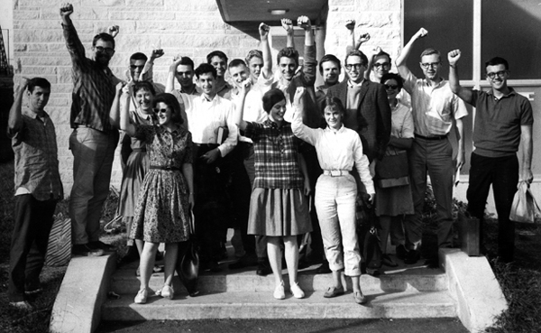
Case Studies
Students for a Democratic Society (SDS)
The Weather Underground
Movement for a New Society (MNS)

Slide 8
What Difficulties Did These Movements Encounter?
Outside Pressure and Police Repression/Infiltration
The Emergence of an Unofficial (Unaccountable) Leadership
Jo Freeman, “The Tyranny of Structurelessness”
A Growing Emphasis on Lifestyle Over Strategic Organising
Tension Between Building Organisations Structures and Movement Participation
A Fetish for Consensus Decision Marking
Internal Disagreement Over Tactics – Violence v Nonviolence?

Slide 9
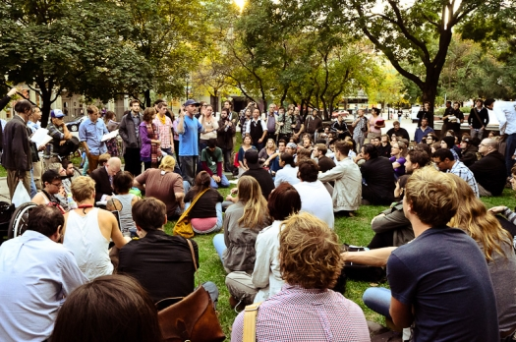
A Fetish for Consensus Decision Marking
Cast Study: Movement for a New Society + Students for a Democratic Society

Slide 10
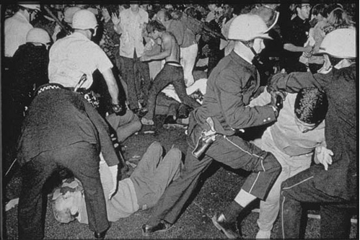
Internal Disagreement Over Tactics – Violence v Nonviolence?
Cast Study: The Weather Underground

Slide 11
Concluding Remarks
“I have this confidence welling up in me now that when you organise your equivalent Movement for a New Society, it will be better than ours. George Lakey quoted in Andrew Cornell, Oppose and Propose: Lessons From Movement for a New Society (AK Press 2011) 122.

