Slide 1
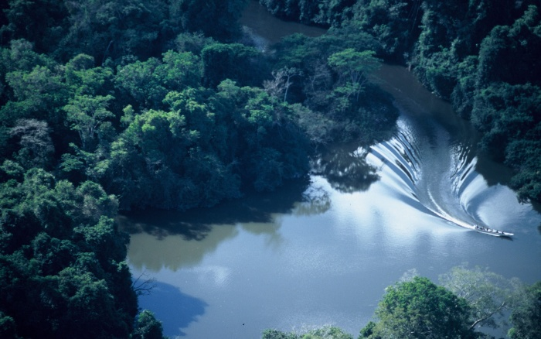
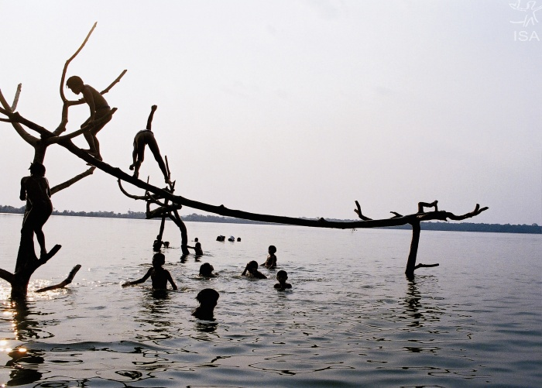
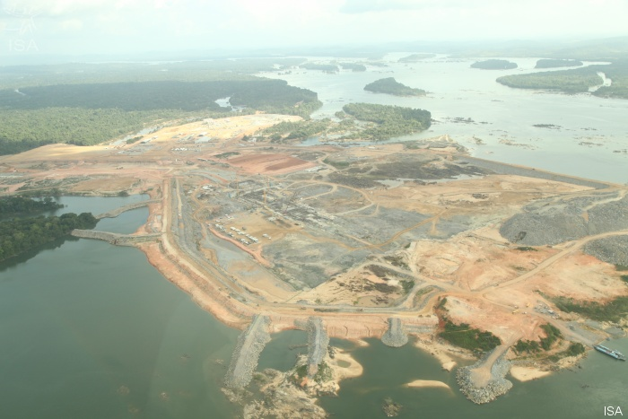
Planetary Boundaries and Saving the Amazon Rainforest
Dr Silvia Serrao-Neumann, Griffith University, Australia

Slide 2
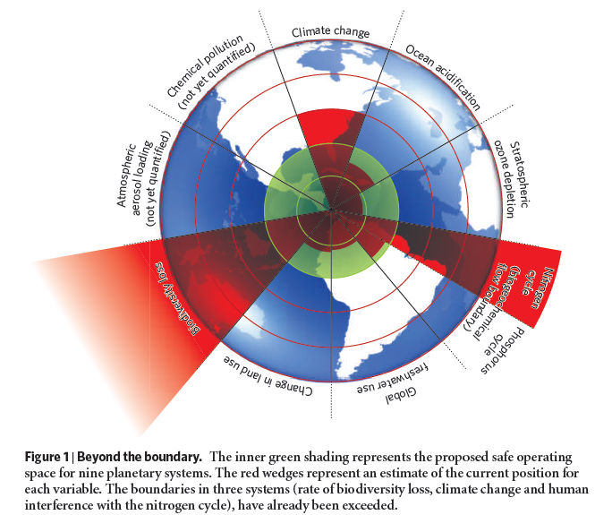
Planetary Boundaries
(source: Rockström et al, 2009)

Slide 3
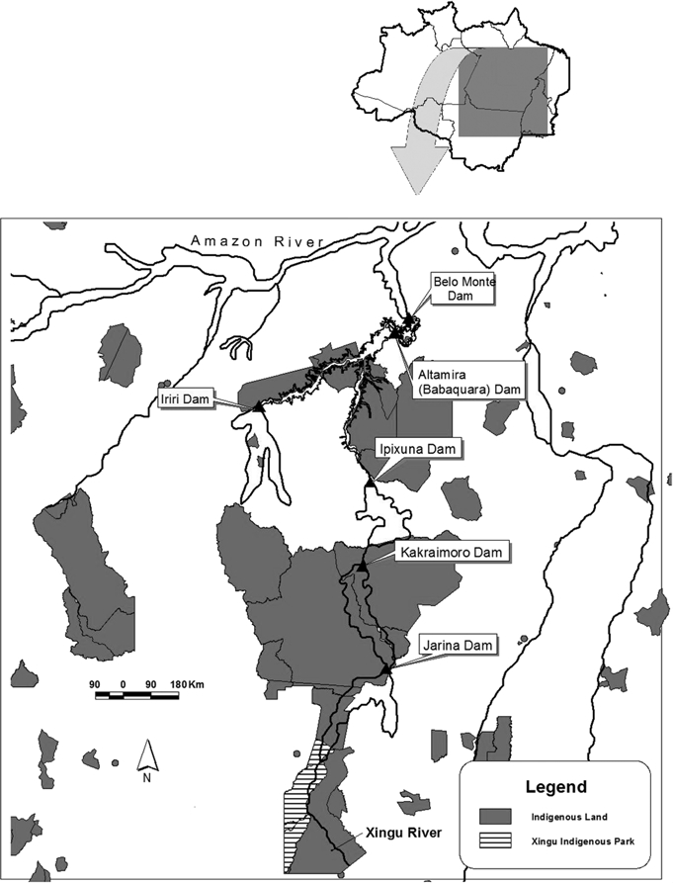
The Belo Monte Hydro-electrical Complex
Original project:
2 large dams – 14,500 km² inundated
Submersion of 1 whole indigenous territory
6,000 people displaced
4 additional upstream dams
Total area inundated: 22,000 km²
12 indigenous groups affected
Revised project:
1 smaller dam – 400 km² inundated
No impact on indigenous territory
5,000 people affected
Source: Fearnside 2006

Slide 4
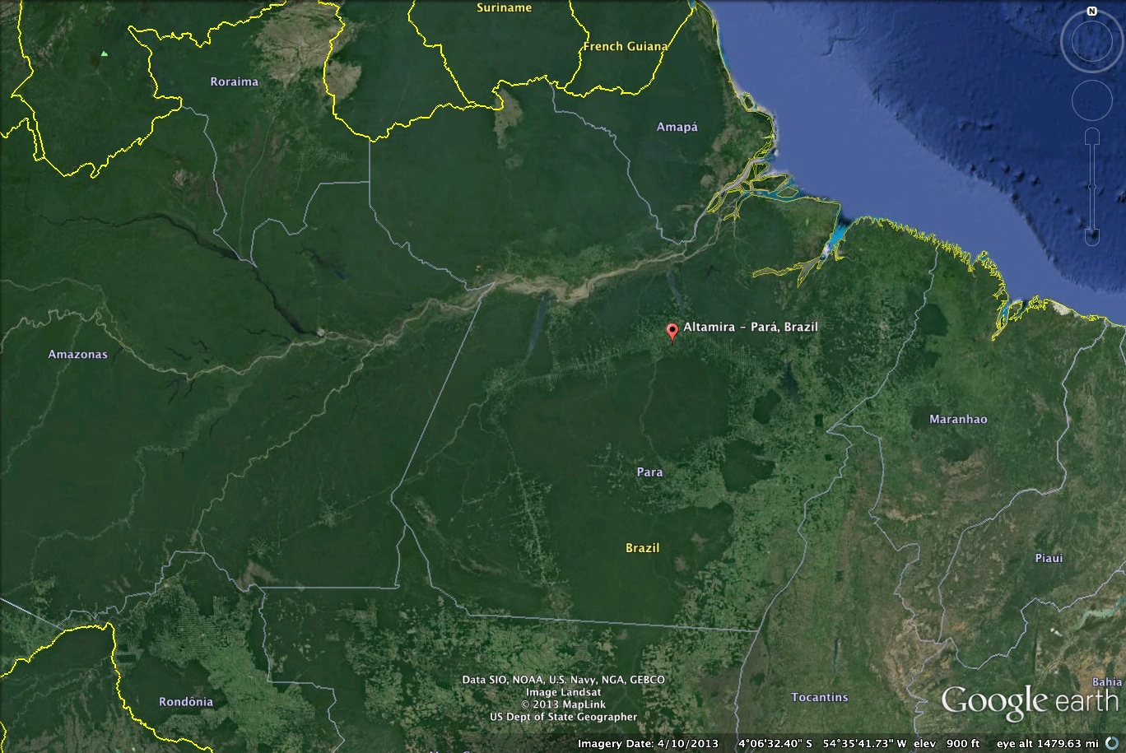
The Region – Xingu River Basin

Slide 5
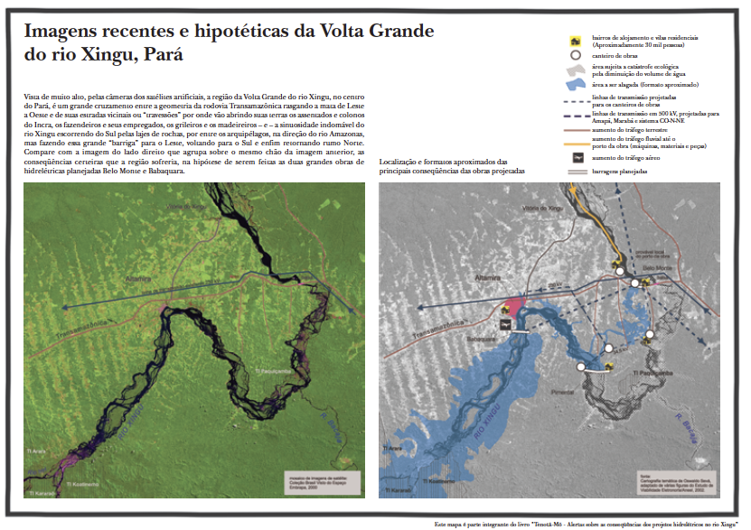
Projected Inundated Area - BMHC
Source: Seva 2005

Slide 6
BMHC – Construction Site

Slide 7
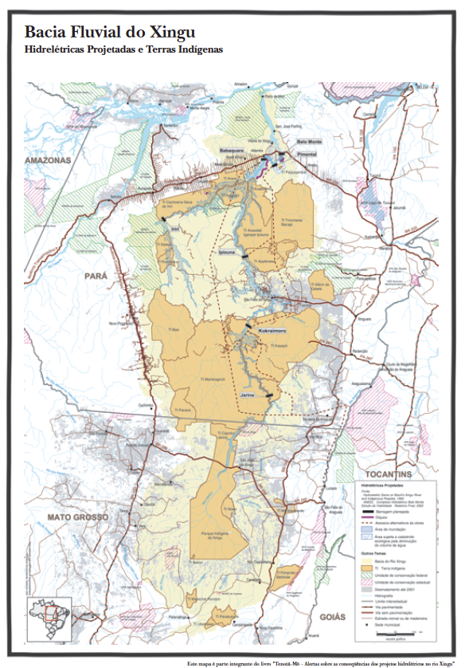
Planned Dams BMHC
Indigenous territory
Proposed dams
Source: Seva 2005

Slide 8
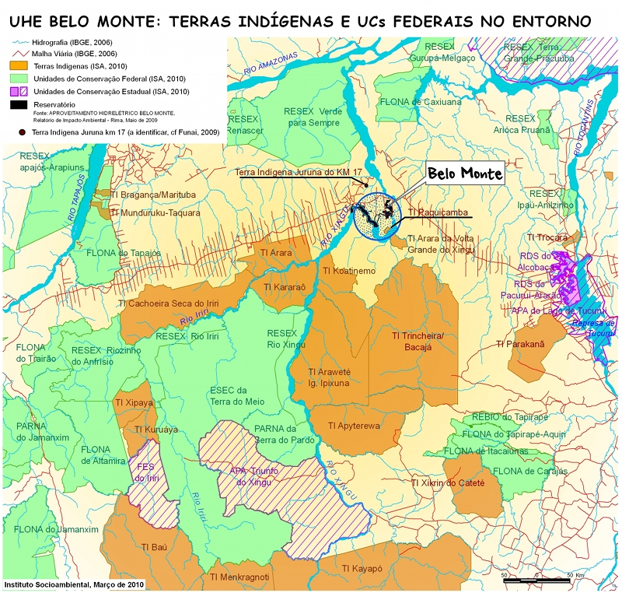
The Region – Indigenous Reservations
Source: Instituto SocioAmbiental

Slide 9
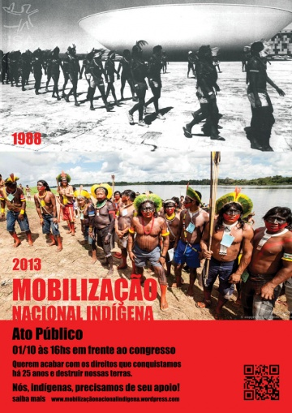
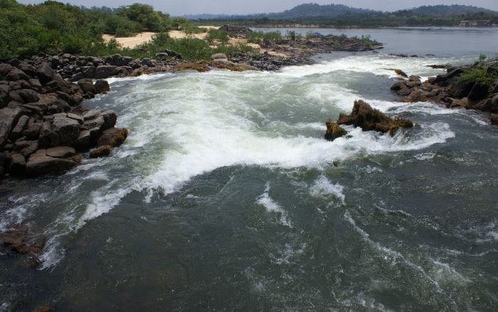
Earth System Governance
Global commons
Source: Instituto SocioAmbiental

Slide 10
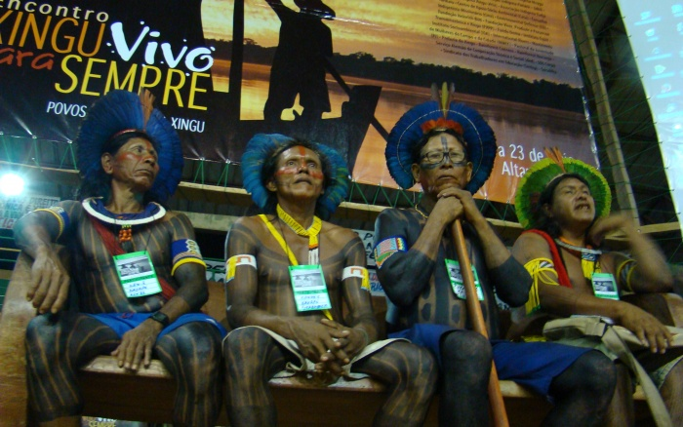
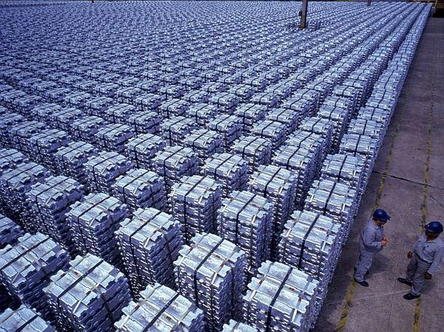
Re-territorialise / de-territorialise
Source: Albras
Source: Instituto SocioAmbiental

